Slide 1
Regulatory challenges and possible approaches in e-finance: Russian experience
Digital BRICS conference, New Delhi, 29.04.2016

Slide 2
The context: digital systems provide increasing financial inclusivity
Considerable proportion of the global population remains unbanked
The share of unbanked or underbanked can be up to 80% of population in some developing countries
On contrast digital mobile becomes the most inclusive infrastructural system in the world
Niger: 14% running water, 10% electricity, 29% literacy, 41% mobile usage
Kenya (urban household): mobile ownership – 98%; any furniture – 90%, bed clothes – 93%
The quickly growing world of e-finance and m-finance brings new challenges for regulators

Slide 3
Global context: supply-side developments
The penetration of digital technologies radically decreases costs of processing of financial transactions
This enables a decrease of minimum sum of institutionalized financial operations, with the growing significance of e-microfinance:
e-Micropayments
e-Microsavings
e-Microinsurance
e-Microcredit
Especially the accounts at mobile operators give effectively the same functionality as a bank account becoming the basic account of choice

Slide 4
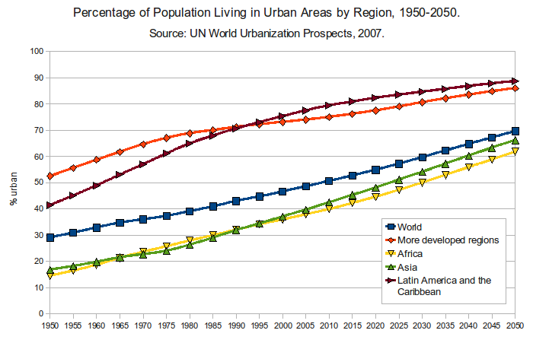
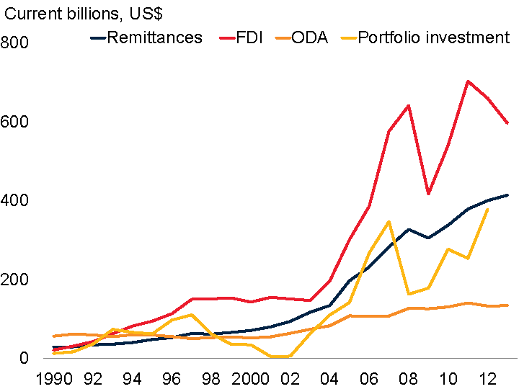
Global context: demand-side developments
“Exponential finance”: expansion of number of people involved in monetary transactions and the number of transactions per person per period
Urbanization
Labor migration
Move from subsistence agriculture to market-oriented production
Traditional banking is not capable of handling the whole of the phenomenon, leaving a wide niche
Broad coverage of the customer base with extremely low cost per transaction – the value proposition of digital platforms

Slide 5
The “exponential finance” brings new challenges for regulators and market actors
The “shadow banking” is viewed as a major risk since the crisis of 2008:
Financial risks: destabilization of the system, “bubbles”
Social risks: artificially boosted consumption, leading to mass default; rogue schemes exploiting customers’ lack of experience
Technical risks: losses due to lack of compatibility and robustness of the systems
On the other hand the players alternative to traditional bank are increasingly important as the institutes of economic and social development: “parallel banking” in the place of “shadow banking” (AFI)
Mobile operators
Microfinance
E-wallets
Payment transfer systems
P2P platforms
Cryptocurrencies
How to arrive to a pragmatic balance in regulation? Risk-proportionate regulation is the “buzzword”

Slide 6
Two possible regulatory approaches
Non-banks are restricted to back-end operations with no room for intermediation (i. e. using the customers’ money as funds for operations): the current approach in Russia
Certain space for non-banks in financial intermediation
How do market players act within these approaches?
Russian experience studied through cases of 4 important market players

Slide 7
Place in the value chain defines the strategy of market players towards regulatory standing
 | Middle-of-chain oriented | End-customer-oriented
Regulatory strategy | Non-bank | Bank\Quasi-Bank
Cases: credit risk assessment, POS terminals for bank cards acquiring
Deliberately structured to avoid the need to be regulated as banks
Easy to launch, but restriction in strategic opportunities
Cases: e-wallets, cash-in terminal, virtual cards
Can be legal only with a bank license
No restrictions in development, but early stage of experiments is a major challenge

Slide 8
Possible development of regulatory approaches
Regulators need to recognize various financial technology developers as legitimate and important market players. Overall the ecosystems around digital financial platforms are capable of catering to almost all viable personal money management strategies of the unbanked and underbanked customers in emerging as well as in advanced economies.
There is ambivalence in the social role of the digital platforms
They speed up the acquisition of personal financial skills and competences. In this, the platforms may be destructive for the traditional social patterns, promoting atomization of society. They are empowering the more entrepreneurial individuals, but may put psychological stress on others.
They often work to bring people together in new settings and roles, creating social fabrics of another order, supporting and stimulating civil initiative via instruments of crowdfunding.
The phenomenon of digital finance requires new competences from the regulators.
It is important to distinguish between the effects of the platforms and those of their applications
Mitigation of social risks, as the needs of inexperienced customers can be exploited by non-ethical market players for profiteering.
The challenge for modern regulators in emerging markets: taking the risk-proportionate actions, promoting the financial literacy, which leads to effective choices of financial instruments by the consumers, avoiding the temptation of playing a Big Brother (arbitrary limitation of the scope of personal money-management strategies).

Slide 9
Vladimir Korovkin
Head of Innovations and Digital Research
Skolkovo Institute for Emerging Markets Studies Vladimir_Korovkin@Skolkovo.ru
iems.skolkovo.ru

