Slide 1
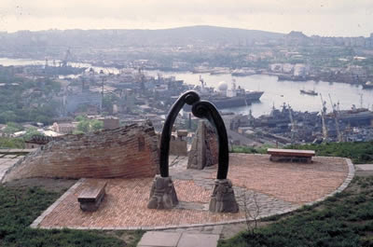
Far Eastern Federal University
School of Art, Culture and Sport
Graphic Design Department
International Friendship Park, as a symbol of good-neighborly relations between the countries of the Pacific region
Alexey V. Parnyakov
Associate Professor,
School of Arts, Culture and Sport,
Far-Eastern Federal University, Russia
E-mail: avparnyakov@mail.ru

Slide 2
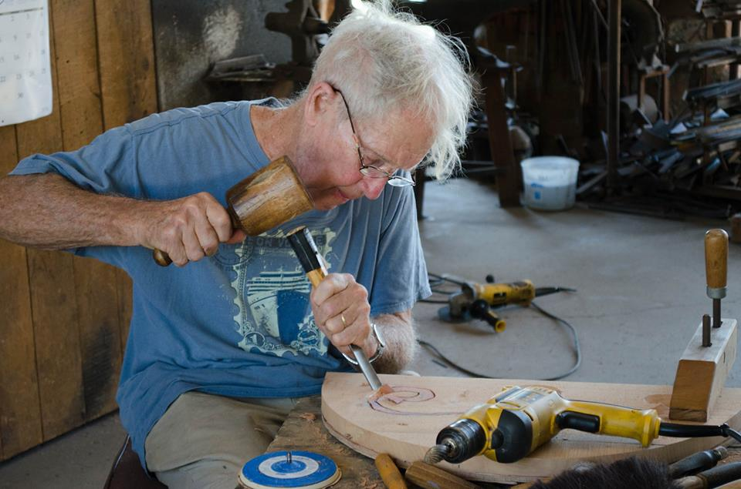
Thought leader and inspirer, artist and designer:
James Hubbell
http://ilanlaelfoundation.org/

Slide 3
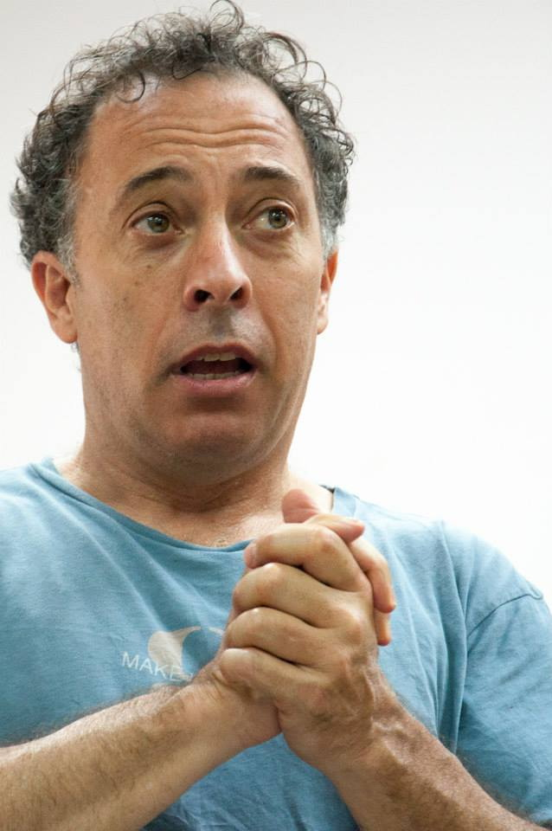
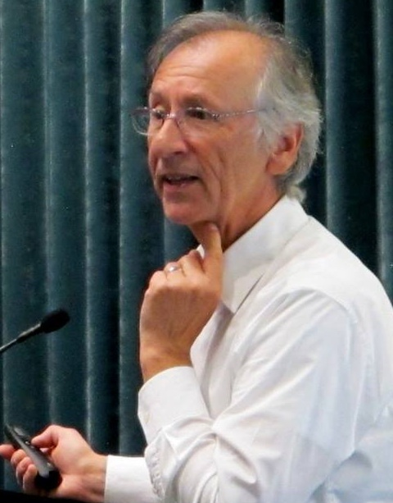
Creative team under the leadership of:
Kyle Bergman
architect
Milenko Matanovich
Psychlogist
http://www.bergmandesignteam.com/
http://pomegranatecenter.org/.

Slide 4
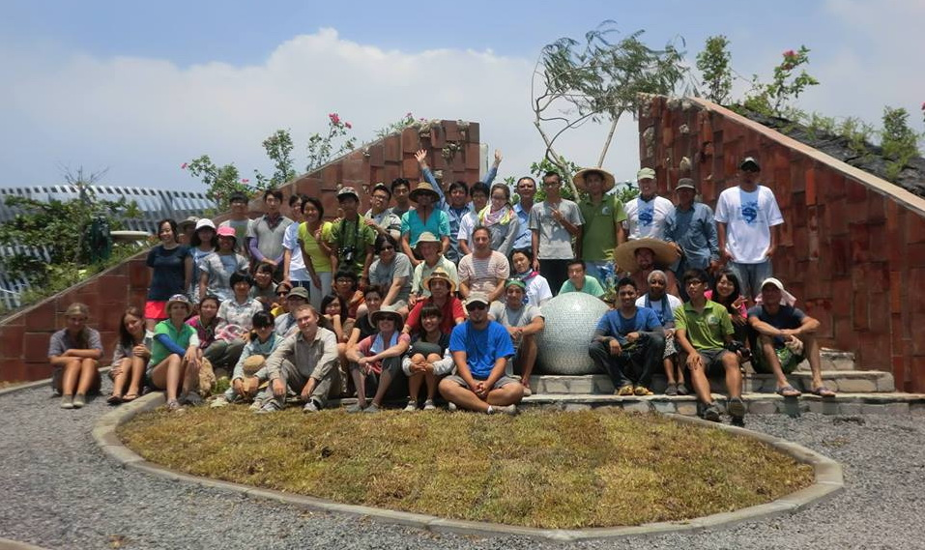
International creative team of volunteers including students and teachers

Slide 5
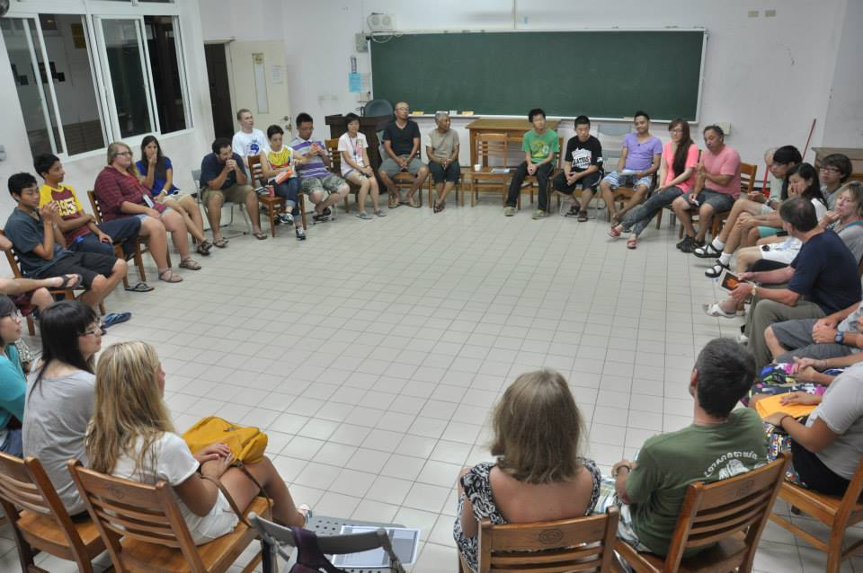
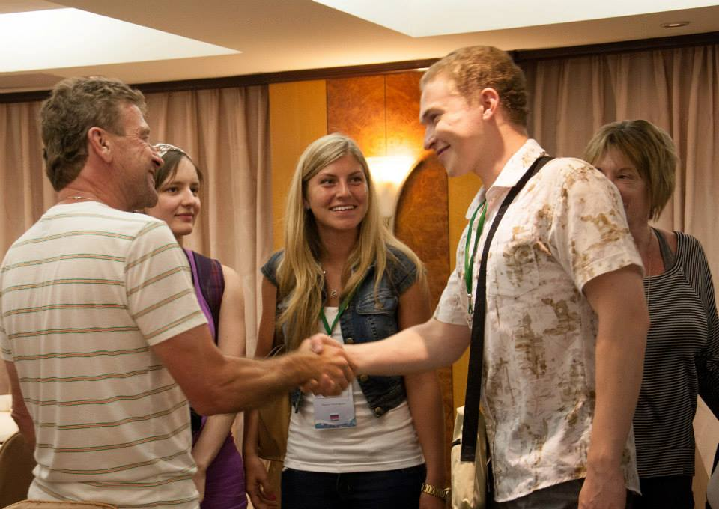
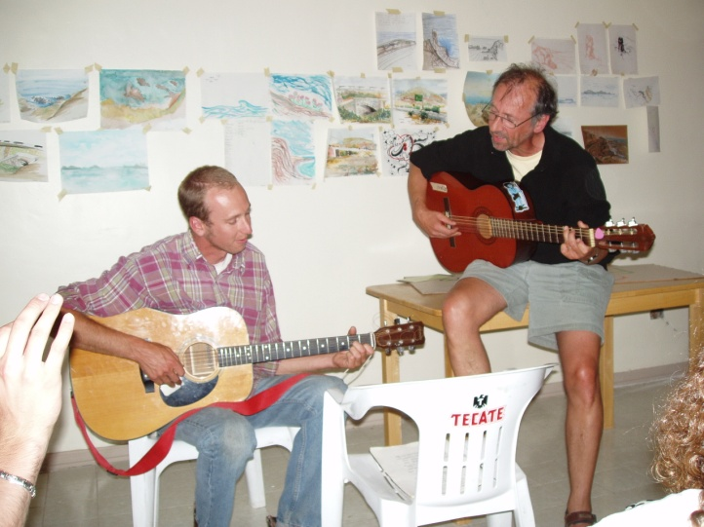
Week 1. Round table. Relationship between the participants. Cultural presentations of countries

Slide 6
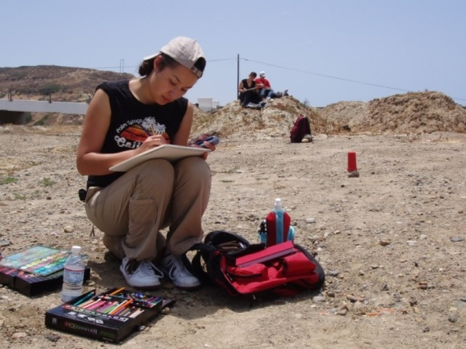
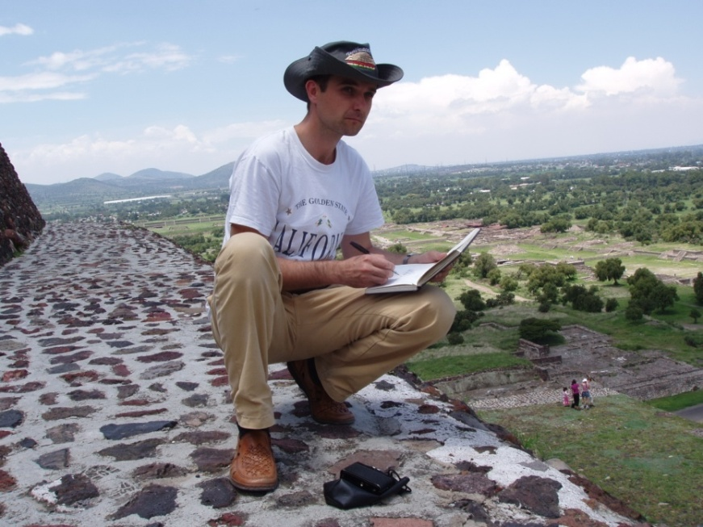
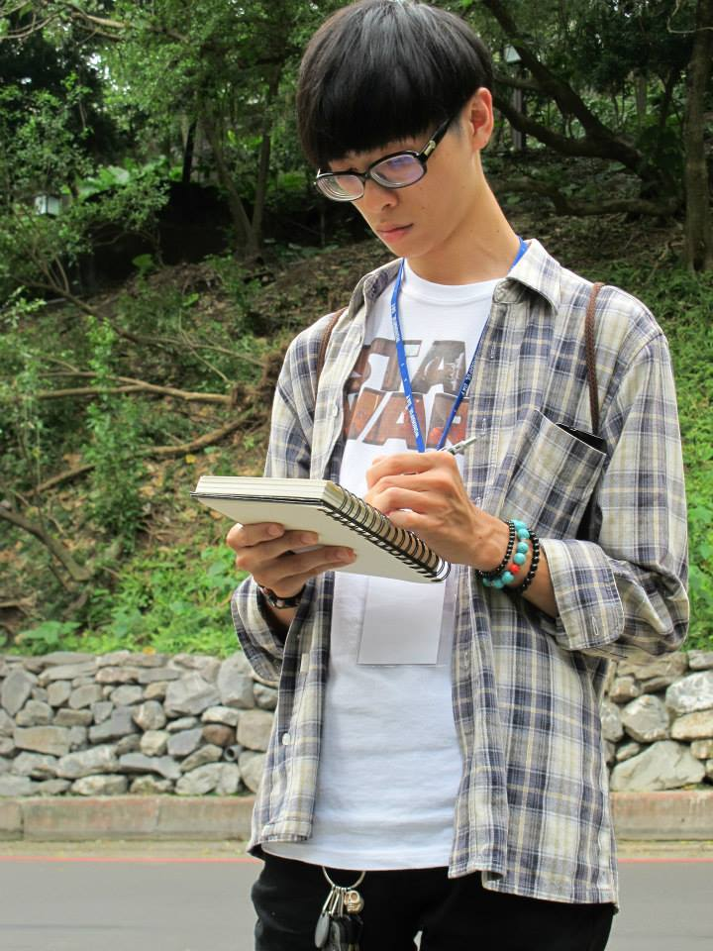
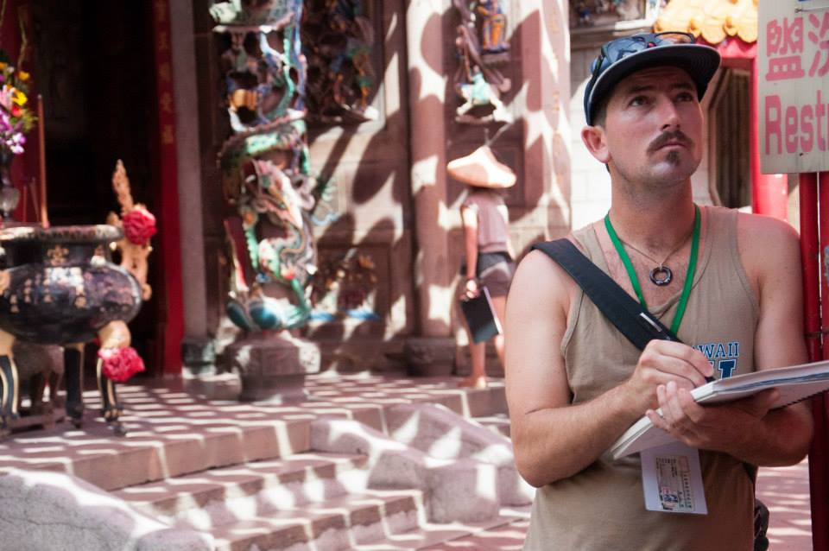
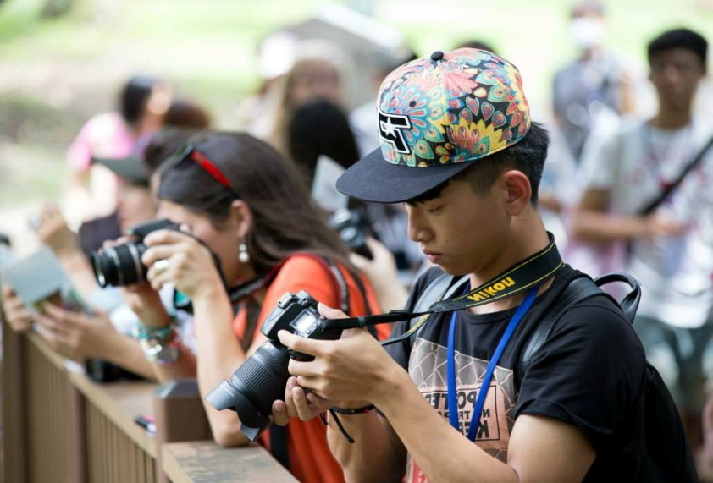
Week 1. Drawings and sketches

Slide 7
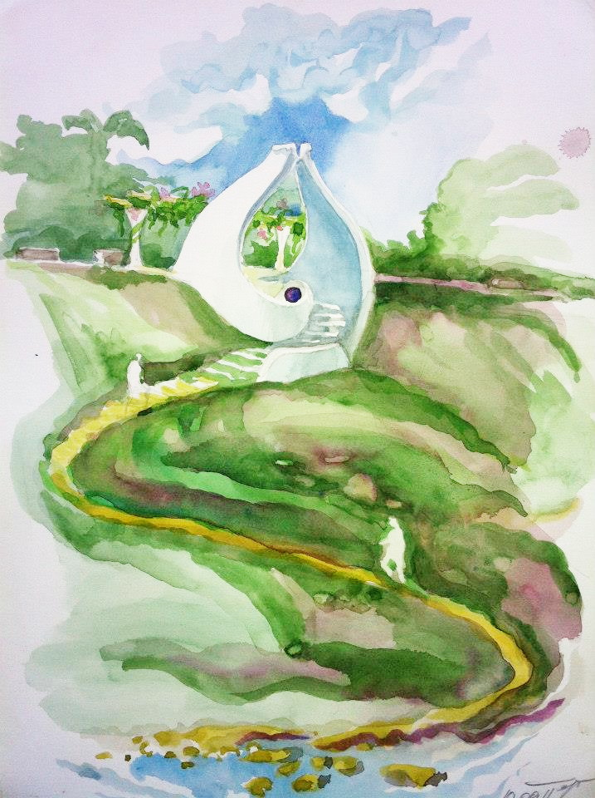
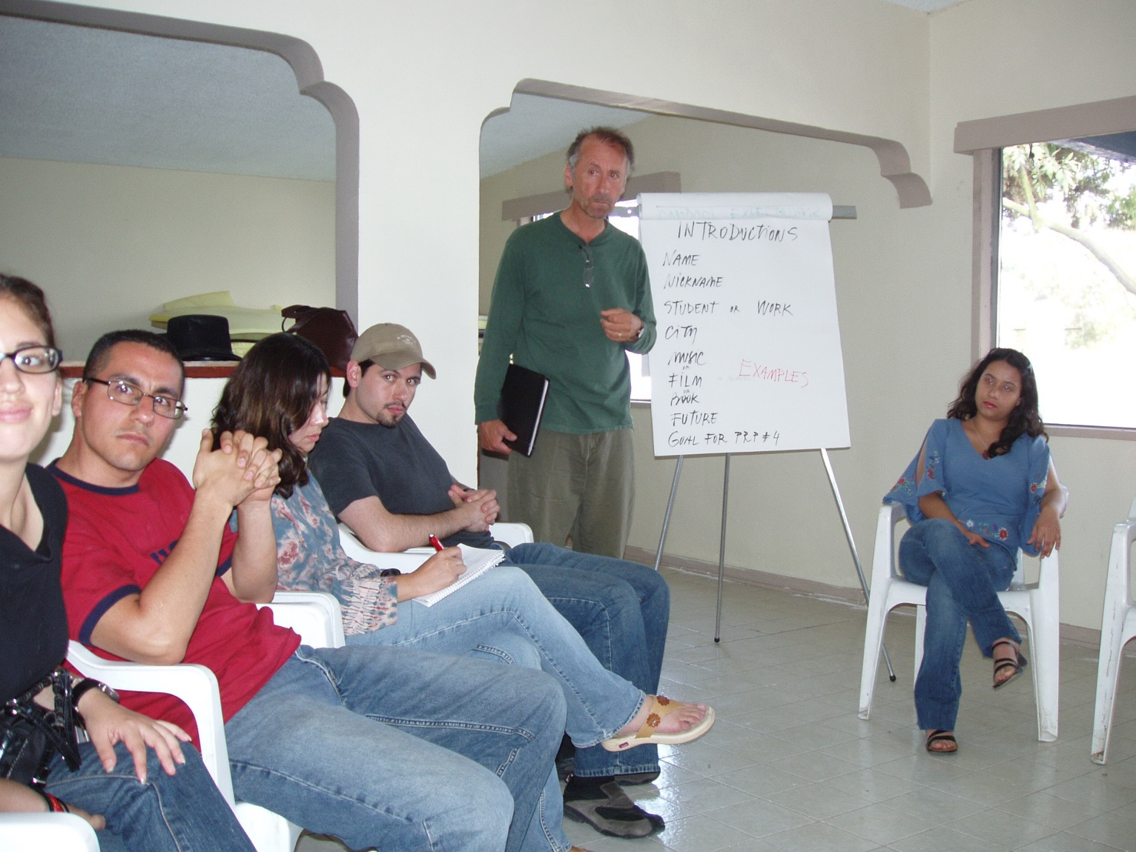
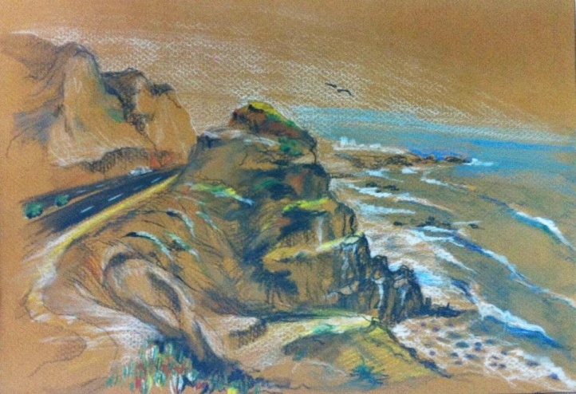
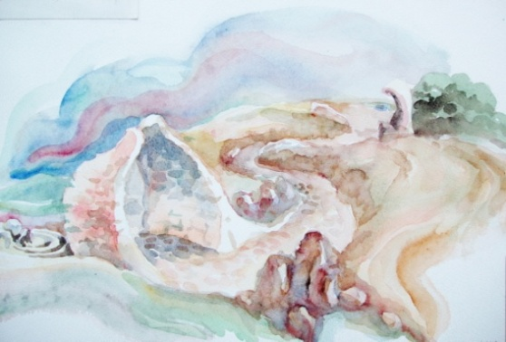
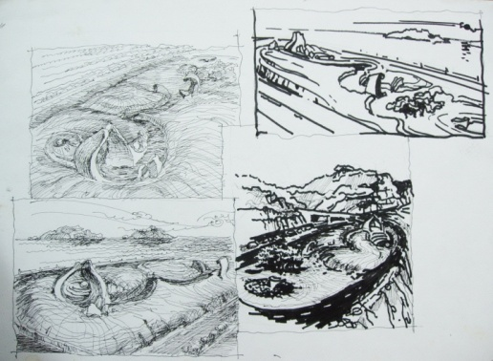
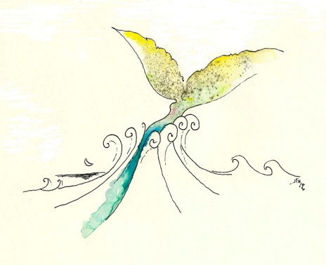
Week 1. Discussion of sketches

Slide 8
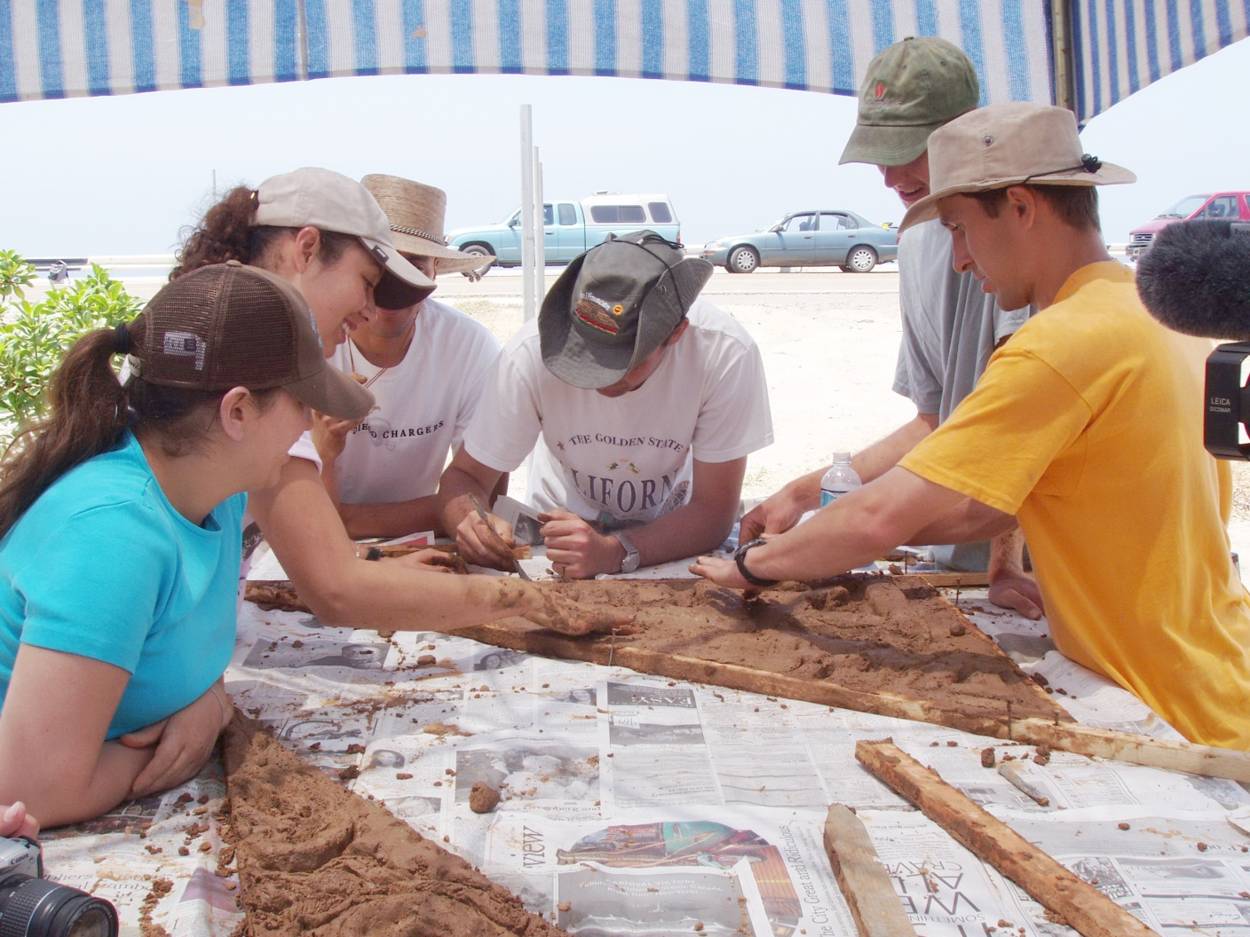
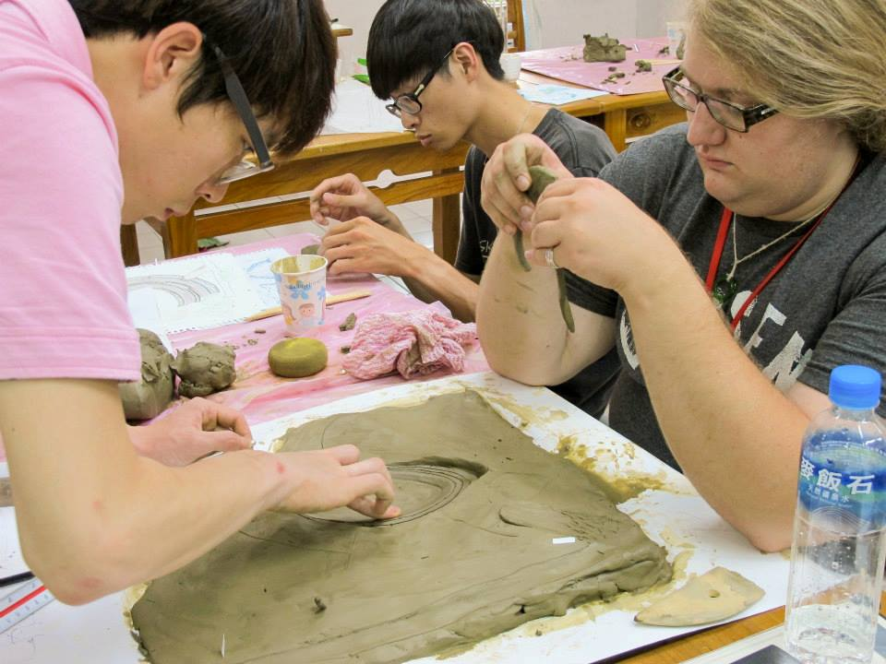
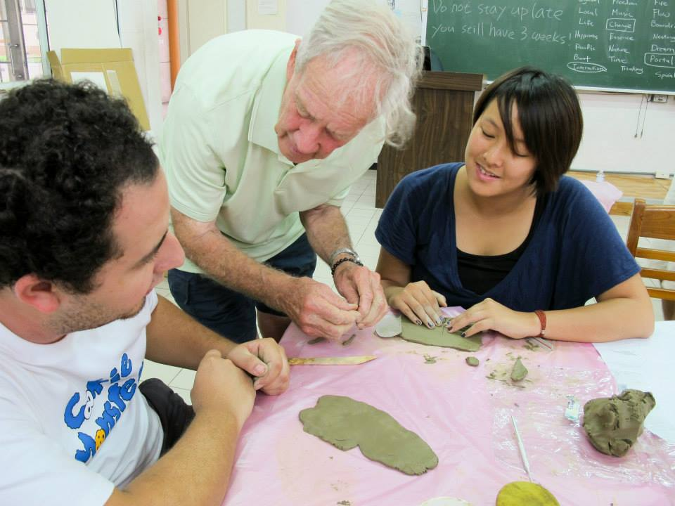
Week 2. Work on the model

Slide 9
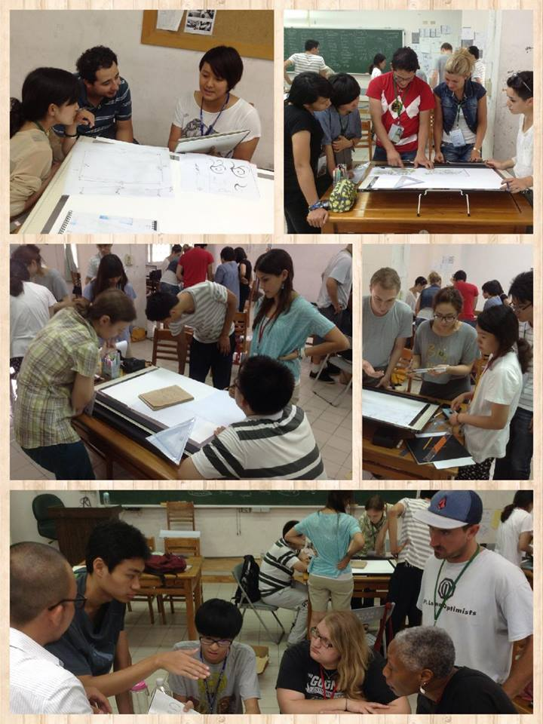
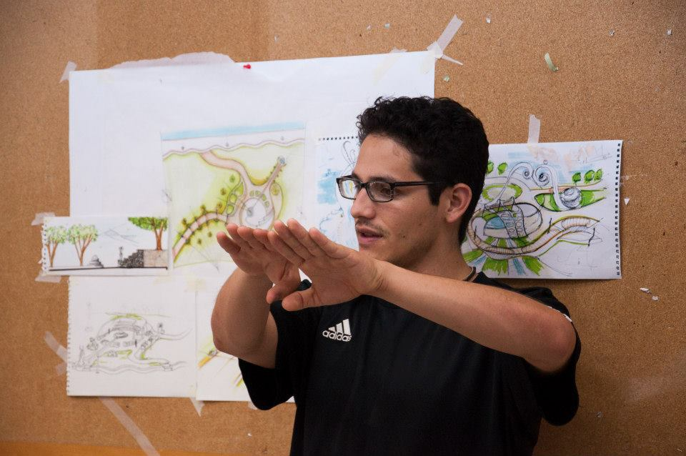
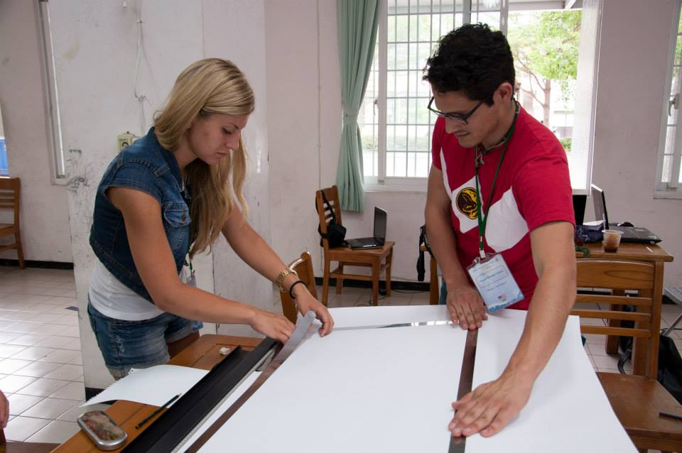
Week 2. Creating conceptual project

Slide 10
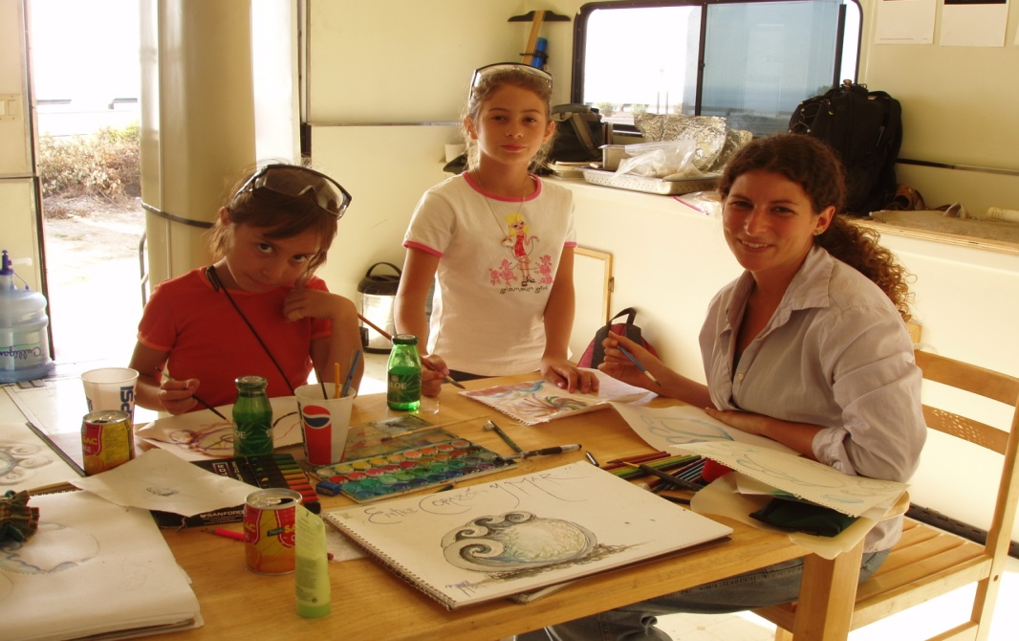
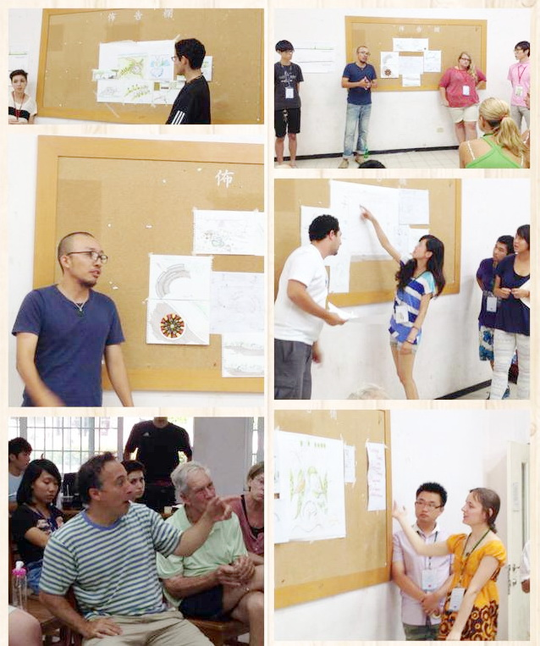
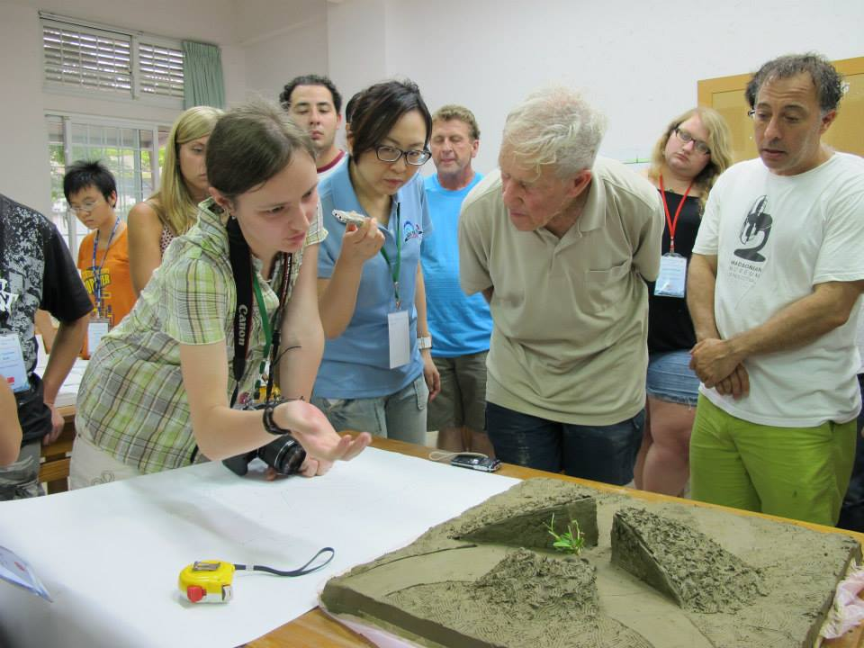
Week 2. Creating conceptual project and discussion

Slide 11
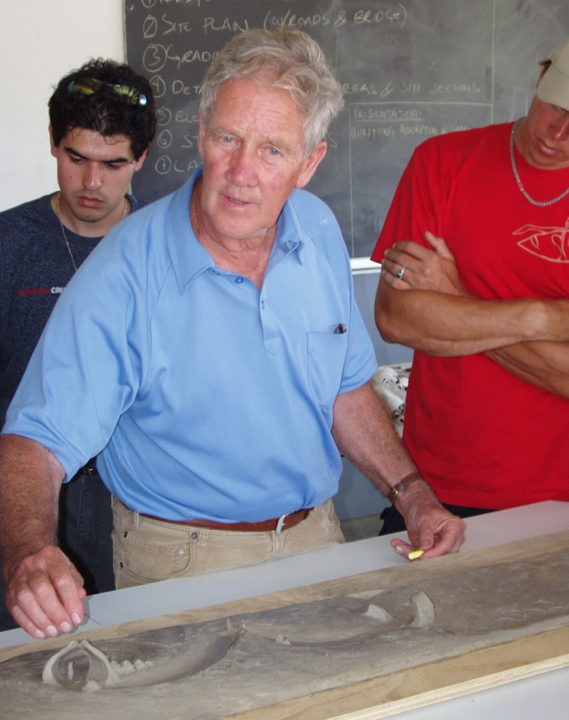
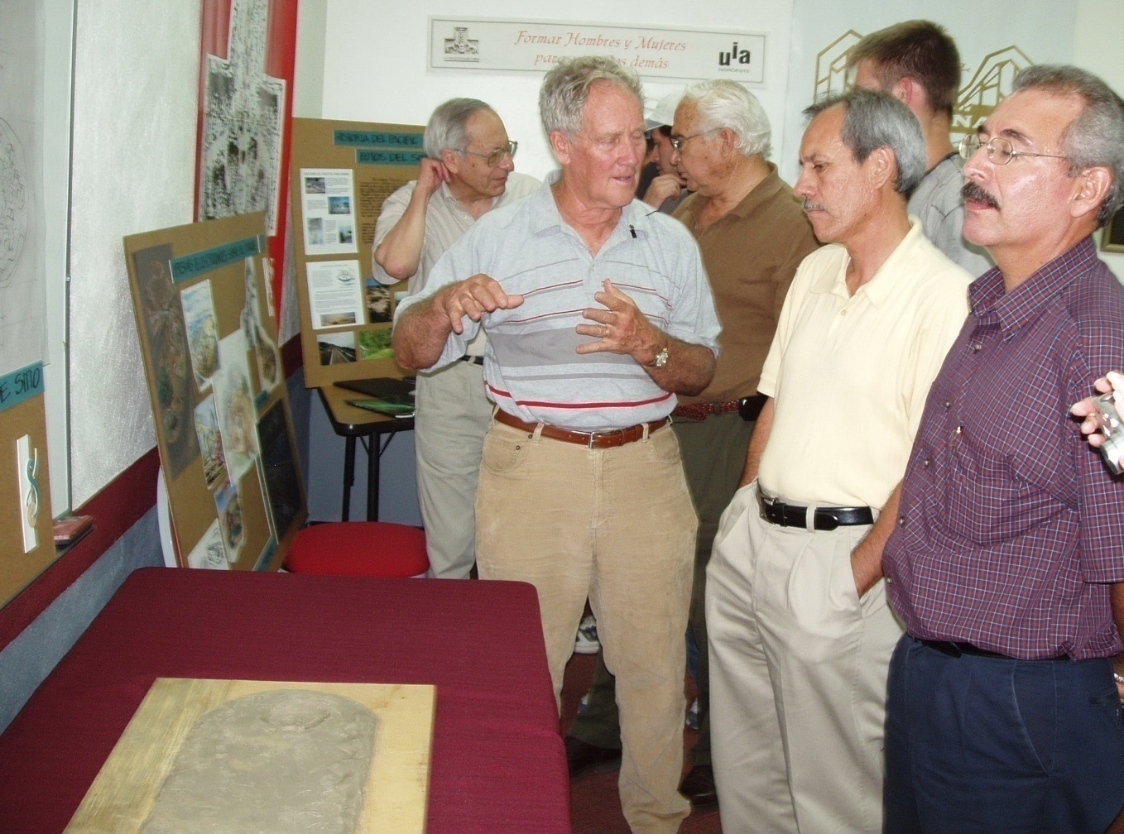
Week 2. Presentation of preliminary project to sponsors

Slide 12
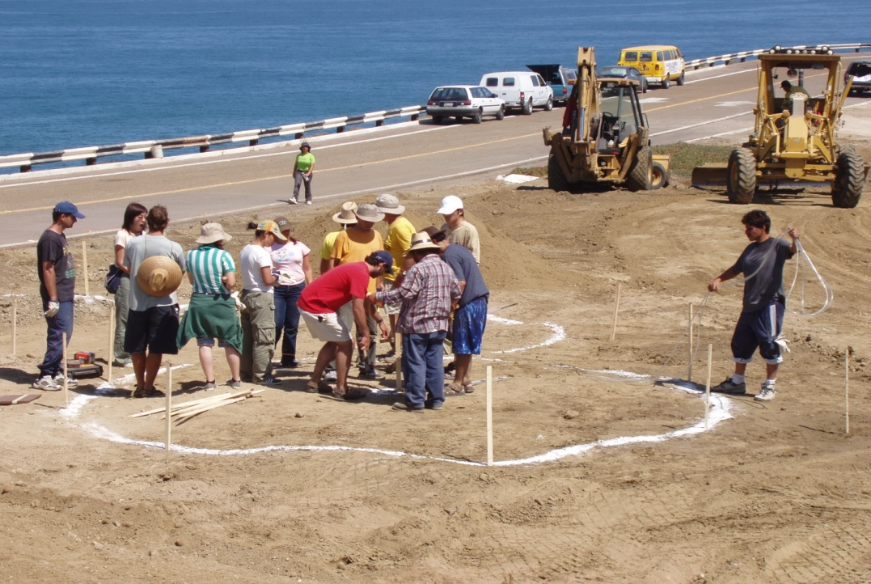
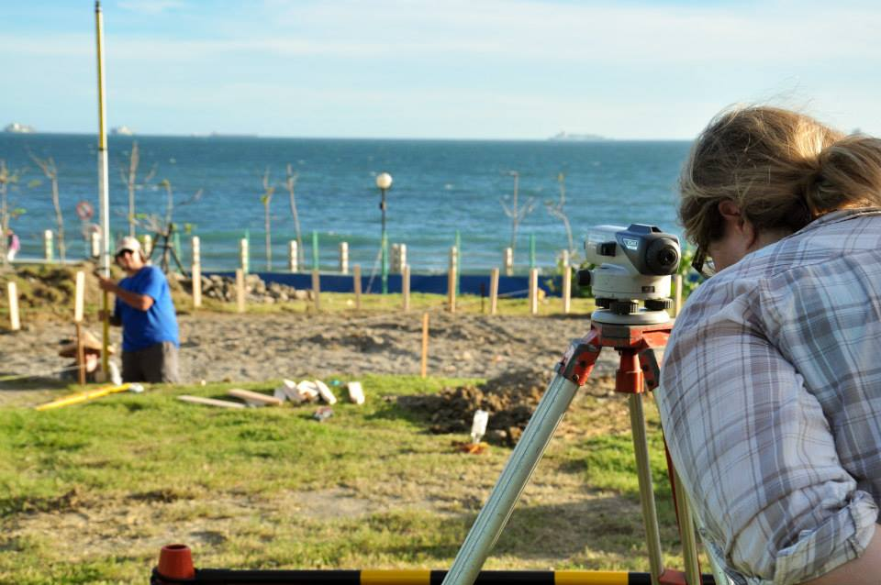
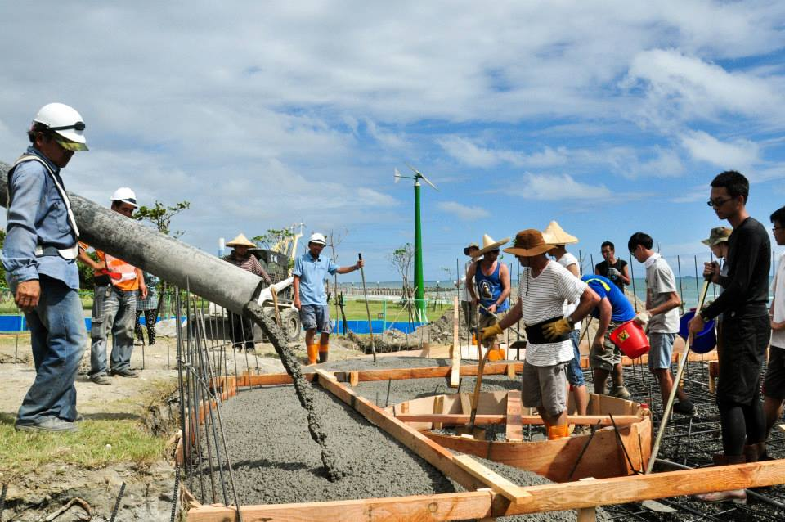
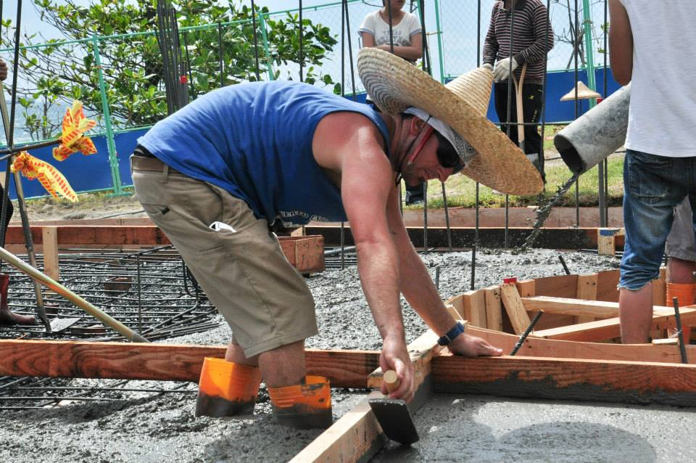
Week 3. Start of construction of the park

Slide 13
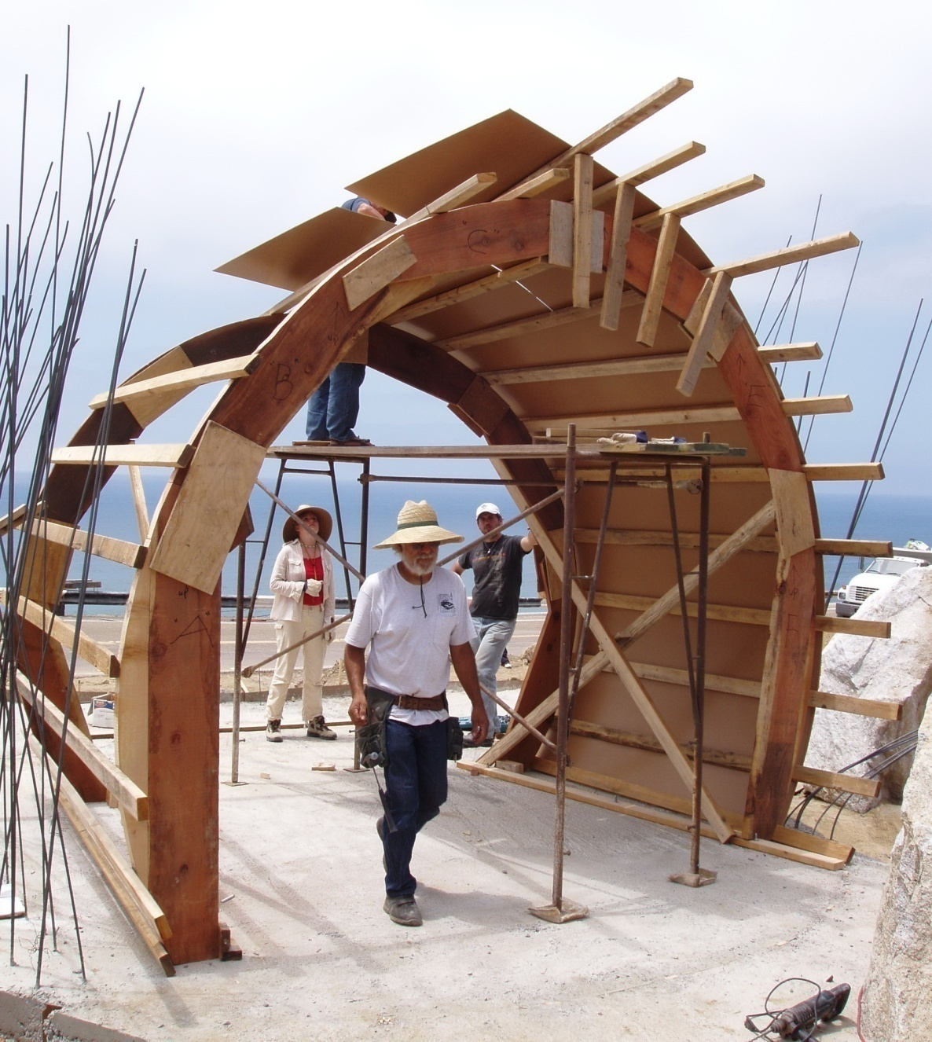
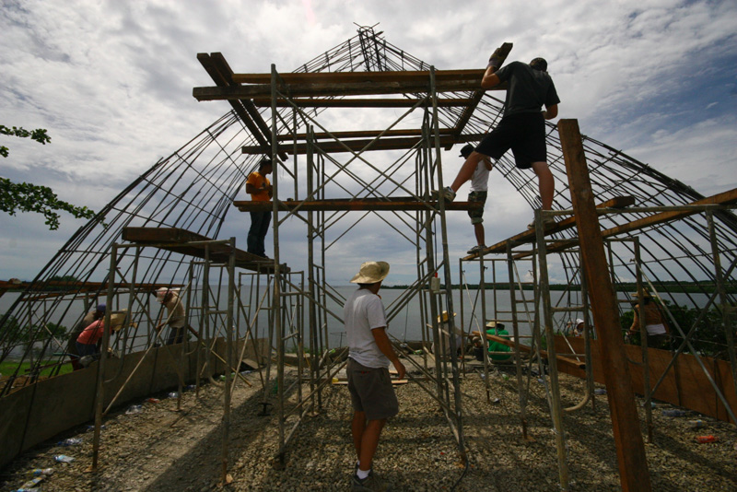
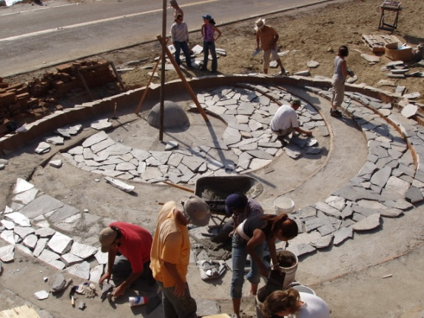
Week 3. The process of construction of the park

Slide 14
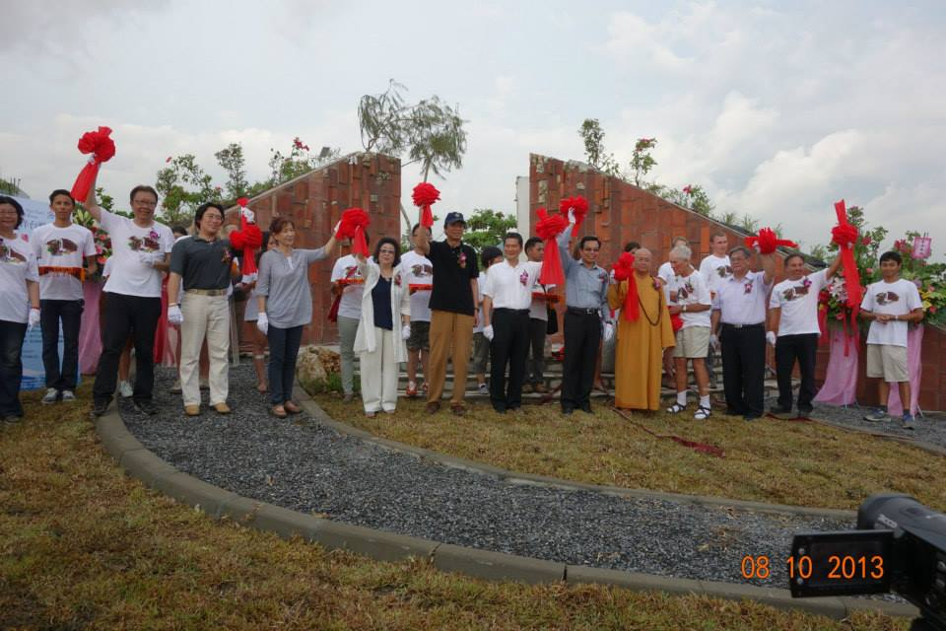
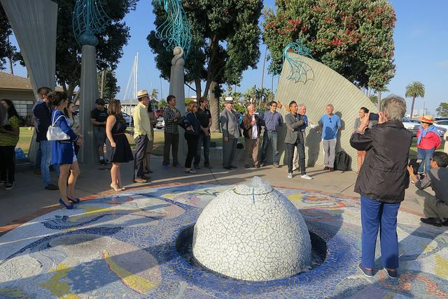
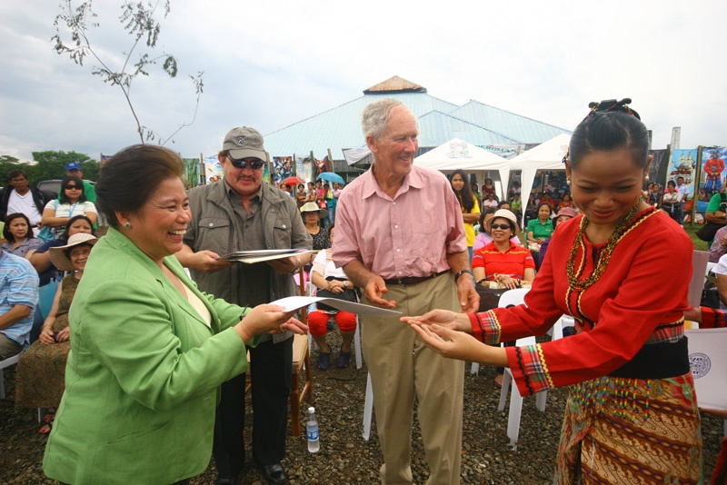
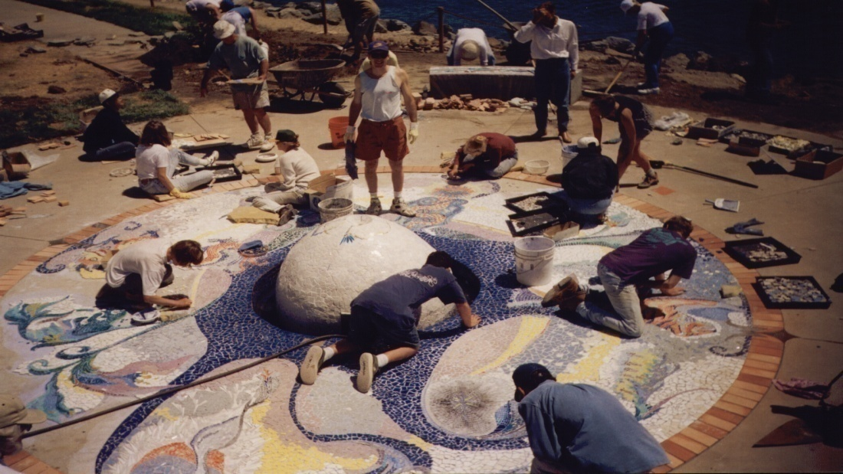
Week 4. Completion.The opening ceremony of the park

Slide 15
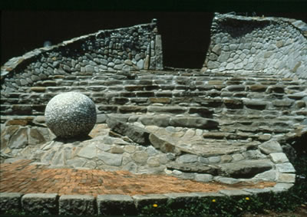
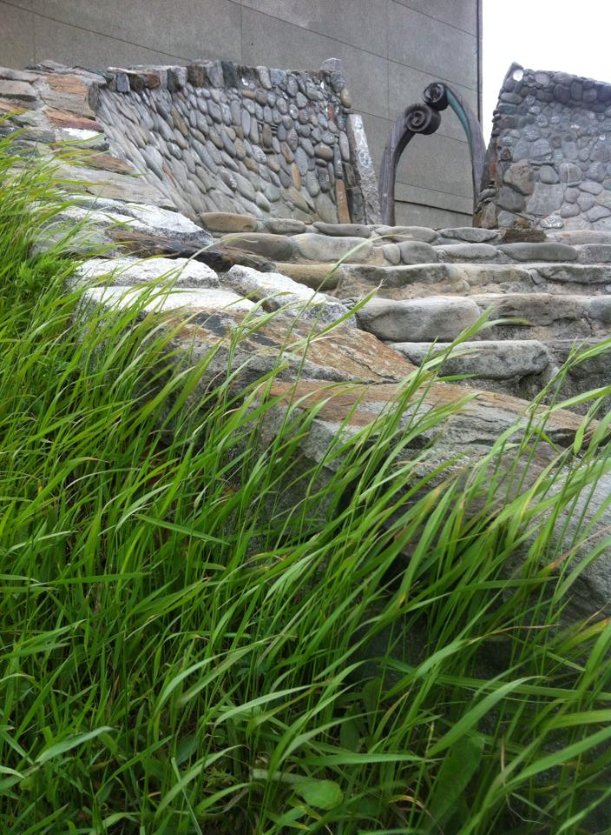
The chronology of the construction of parks:
1. Soul and Soil Park #Vladivostok (Russia) #1994

Slide 16
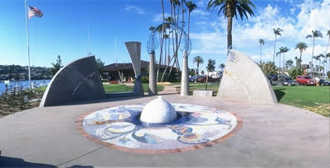
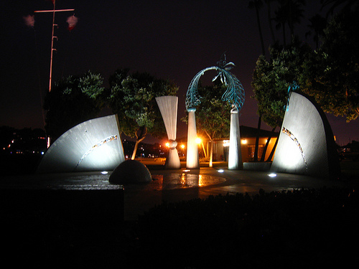
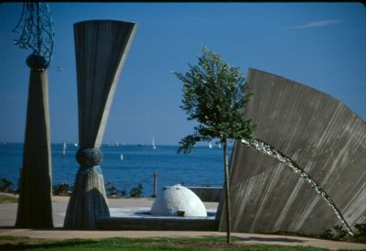
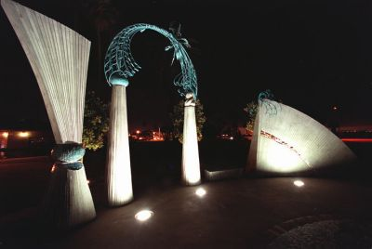
2. Pacific Rim Park # San Diego (USA) #1998

Slide 17
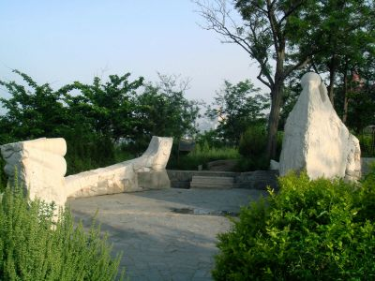
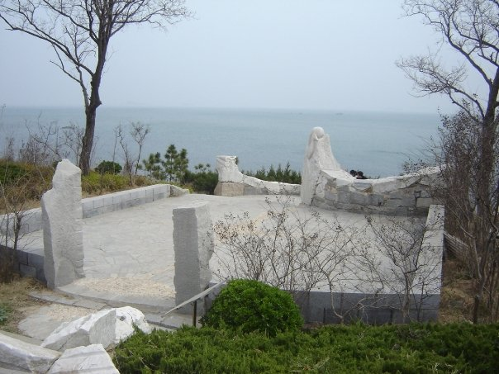
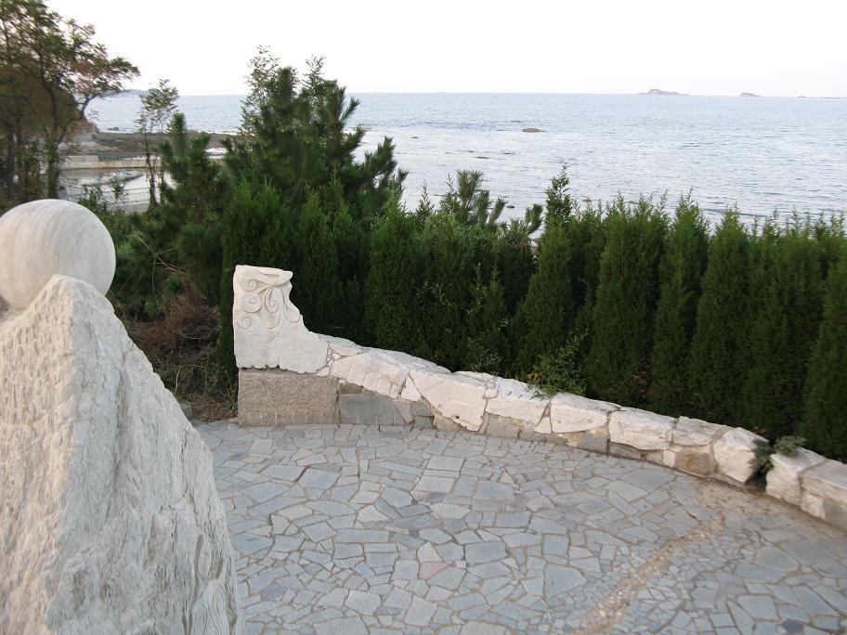
3. Pacific Rim Park # Yantai (China) # 2001

Slide 18



4. Entre Corazon y Mar Park # Tijuana (Mexico) # 2004

Slide 19





5. Salinlahi Pacific Rim Park # Puerto-Princesa (Philippines) # 2009

Slide 20




6. Stepping Stounes of the Pacific # Jeju-Do (South Korea) # 2010

Slide 21




7. Pacific Birth # Kaohsiung (Taiwan) # 2013

Slide 22
Thank you for your attention!

