Slide 1
Sustainable Development Goals 2030: Growth and Inequality
Anna Lobanova
Victoria Pavlyushina
Analytical Center for the Government
of the Russian Federation
Goa, India,
September 20, 2016

Slide 2
Sustainable Development Goals:
General Picture and Inequality
In this Presentation we would like to show the important aspects of Growth and Inequality (SDG #10).
New SDGs cover a broad range of economic - social – institutional objectives – for 2030 while it will take much more time! But it’s important to make the real step now.
For Russia and for other BRICS countries it will be the serious challenge for the social sustainability of Growth and Progress in the Future, to go out of the Middle Income Trap.
Analytical Center is preparing a pilot project (to be published in 2016) on the view on Russia in SDG frame but with an actual socio-economic problems of Russia.

Slide 3
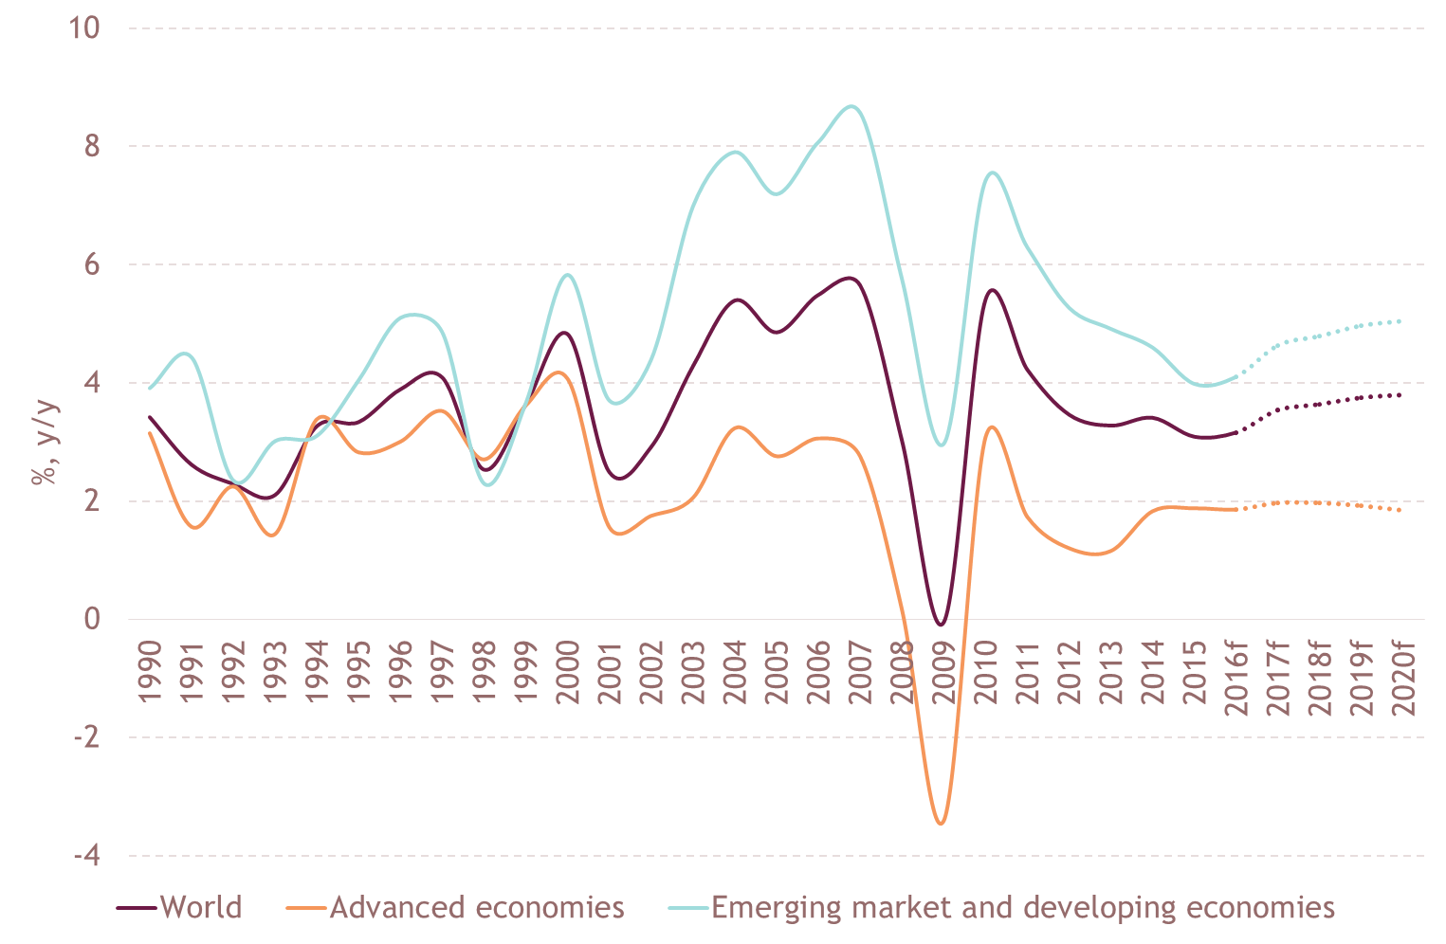
Growth in developed and developing countries

Slide 4
Comparison of BRICS – GDP, inequality
 | Year | Gini ratio | GDP PPP per capita 2014, thousand $ | Income shares by top and bottom deciles in total income, %
 |  |  |  | bottom 10% | top 10%
Brazil | 2009 | 55 | 16,2 | 0,8 | 43
India | 2005 | 33 | 5,8 | 3,7 | 29
China | 2009 | 42 | 13,1 | 1,7 | 30
Russia | 2009 | 40 | 26,1 | 2,8 | 32
South Africa | 2009 | 63 | 13,1 | 1,2 | 52
Germany | 2010 | 29 | 46,2 | 3,2 | 23
USA | 2010 | 38 | 54,4 | 1,9 | 30
Japan | 2010 | 34 | 37,4 | 4,8 | 26

Slide 5
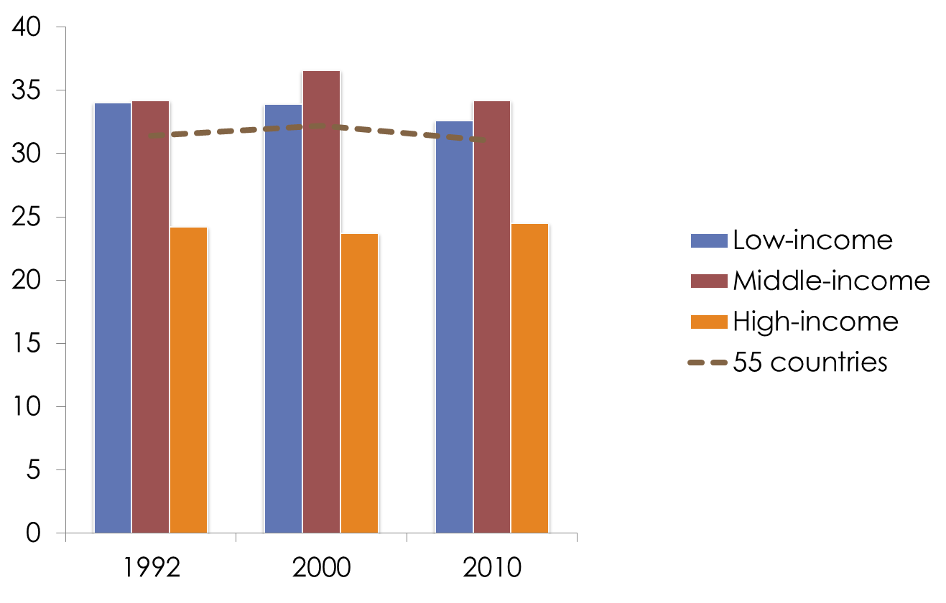
Middle-income countries experienced the noticeable rise in inequality and now are worse than low-income ones in these terms
Development of countries as well the economic growth of recent decades created more inequality at the time of the substantial improvement of average living standards

Slide 6
The problem – economic growth do not provide automatic reducing of inequality
Important - not only income redistribution but also the formation of middle income class and social vertical lifts
The formation of the middle class helps the improvement of civil society.
Civil society required better government, reducing corruption.
These requirements are the integral part of the sustainable development for BRICS countries.
Our common objective is not only to improve living standards but to reach high level of development and mature civil society.

Slide 7
Positive dynamic in reducing inequality and improvement of the government are important parts of the sustainable development
Three factors in evaluating social inequality:
Living standards (GDP per capita etc.)
Level of inequality (Gini, problem of poverty)
Vertical Social lifts (opportunity to make carrier etc.)
Anglo-Saxon inequality is similar to Latin America
but it gives much better chance for personal vertical steps (business or career) during the life time

Slide 8
Complex Objectives for SD
Sustainable ecology
Social conditions: step by step
Climate change prevention and Water, Food etc.
Economy growth and inequality reducing
Sustainable development with respect suppose and encompass structural reforms, which not only adequate, but also timely.
All reforms must be conducted by society in order to prevent economic and/or socio-political crises, which may lead to the stoppages of the development or undermine the sustainability of the development.

Slide 9
Sustainable development goals 2030 – should be somehow different to each country
Human Development Reports (Russia): 2014 and 2015
http://ac.gov.ru/files/publication/a/7198.pd
http://ac.gov.ru/files/publication/a/4758.pdf
Human Development Report 2016 will be a pilot adaptation
of the Sustainable Development Goals for Russia
December 2016

Slide 10
Key issues:
The problem – economic growth do not provide automatic reducing of inequality
Middle-income countries experienced the noticeable rise in inequality
Positive dynamic in reducing inequality and improvement of the government are important parts of the sustainable development
Sustainable development with respect suppose and encompass structural reforms, which not only adequate, but also timely
Sustainable development goals 2030 –
should be somehow different to each country

Slide 11
References:
Anthony Atkinson (2014). Inequality: What Can Be Done?. Harvard University Press. p. 384.;
Branko Milanovic (2016). Global Inequality: a New Approach for the Age of Globalization;
Thomas Piketty (2013). Capital in XXI century;
Leonid Grigoryev, Alla Salmina: “Structure of the social inequality in the Modern World: Problems of Measurement” (in Russian), 2013;
Grigoryev L., Parshina E.. Economic dynamics of the countries of the world in the years 1992–2010: Inhomogeneity of growth — VI BRICS academic forum / editors: Renato Coelho Baumann,Tamara Gregol de Farias. Brasília, IPEA, 2014, pp. 57–77;
Grigoryev L., Pavlyushina V. “Brasil: in the Trap of the Middle Level Development”, (in Russian) 2016.

Slide 12
Thank you for your attention!
Anna Lobanova a.lobanova@ac.gov.ru
Victoria Pavlyushina v.pavljushina@ac.gov.ru

