Slide 1
Future Energy Consumption: Economic Growth and Climate Policy
Leonid Grigoryev
Anna Lobanova
Analytical Center for the Government
of the Russian Federation
Goa, India,
September 21, 2016

Slide 2
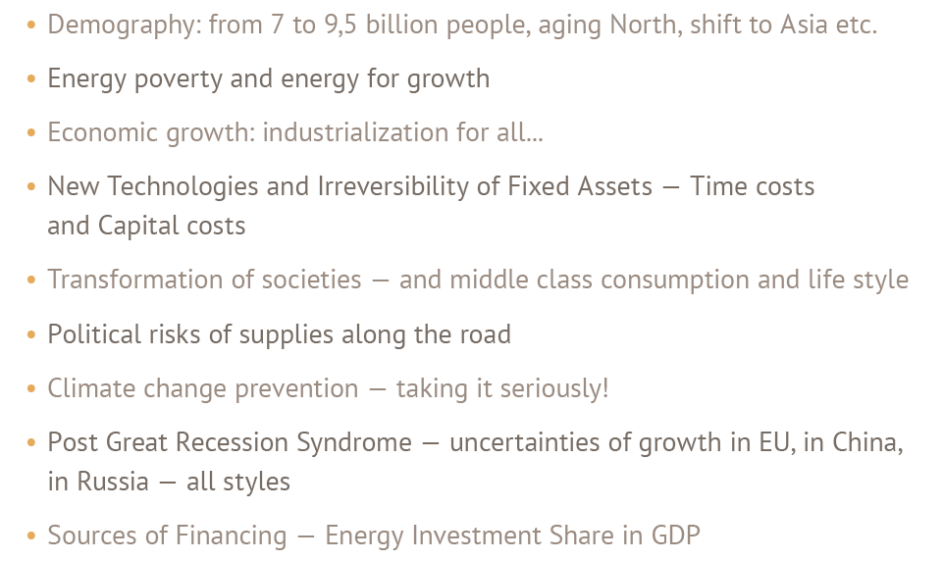

Slide 3
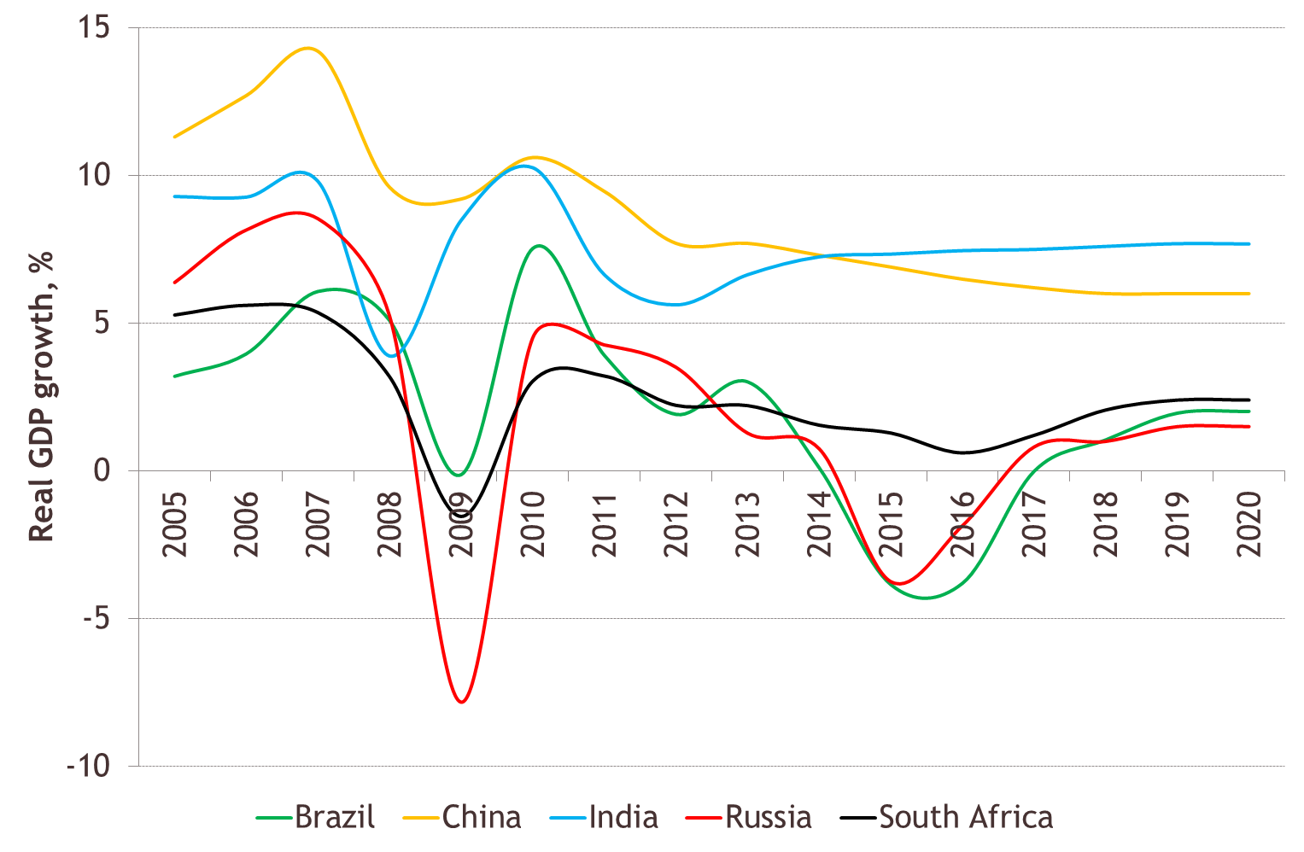
Real GDP growth forecast

Slide 4
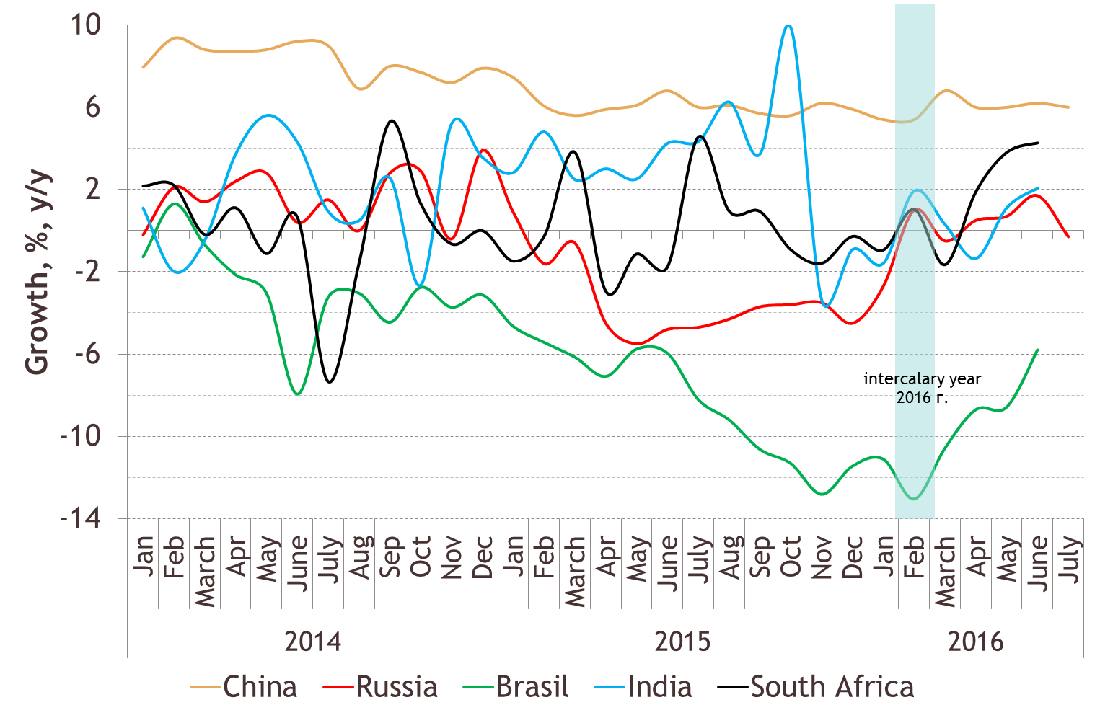
Industrial production

Slide 5
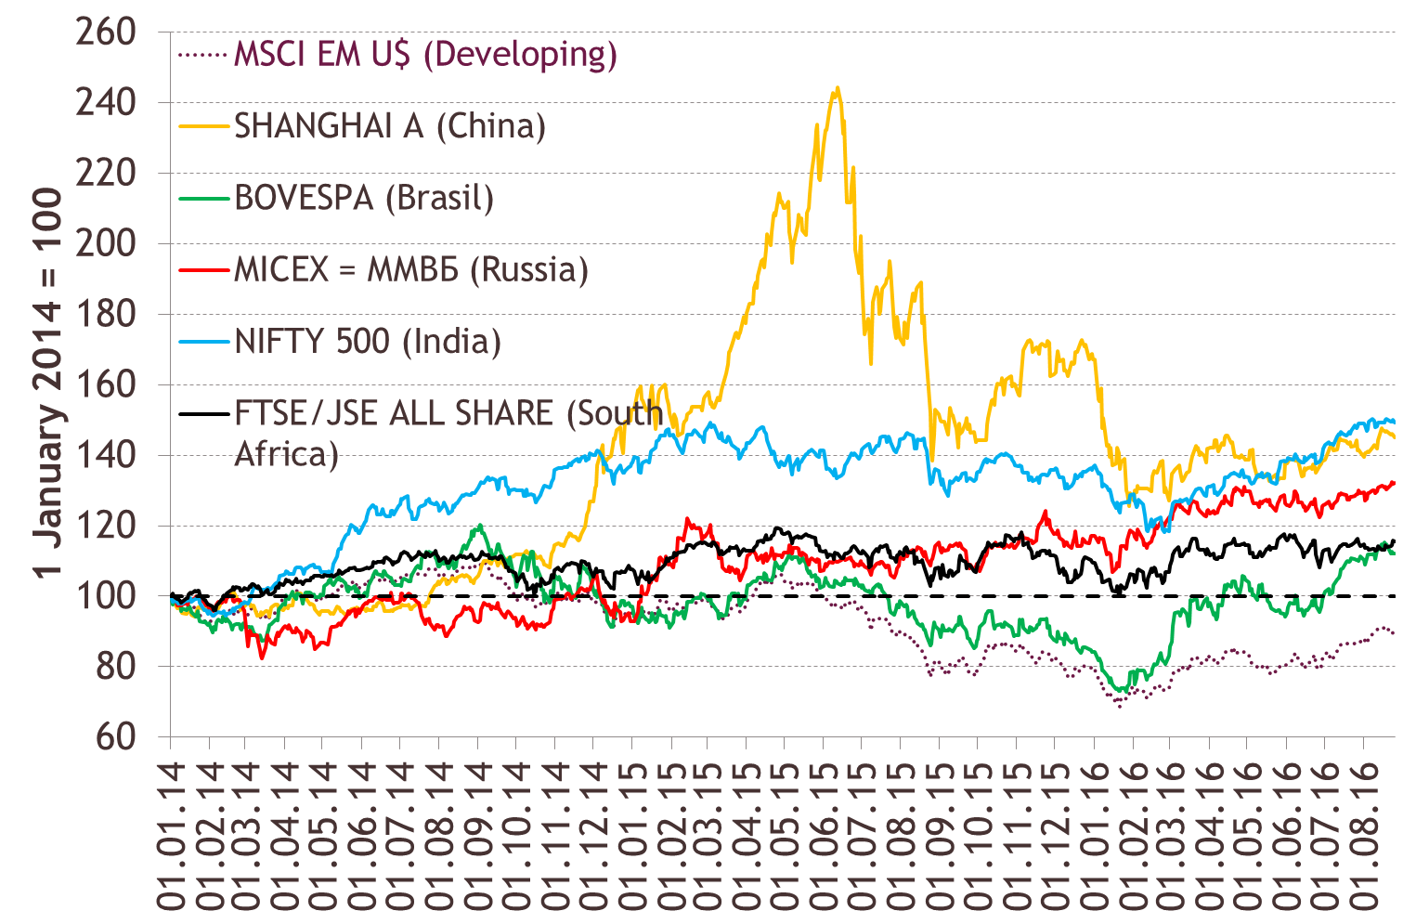
Stock market indices

Slide 6
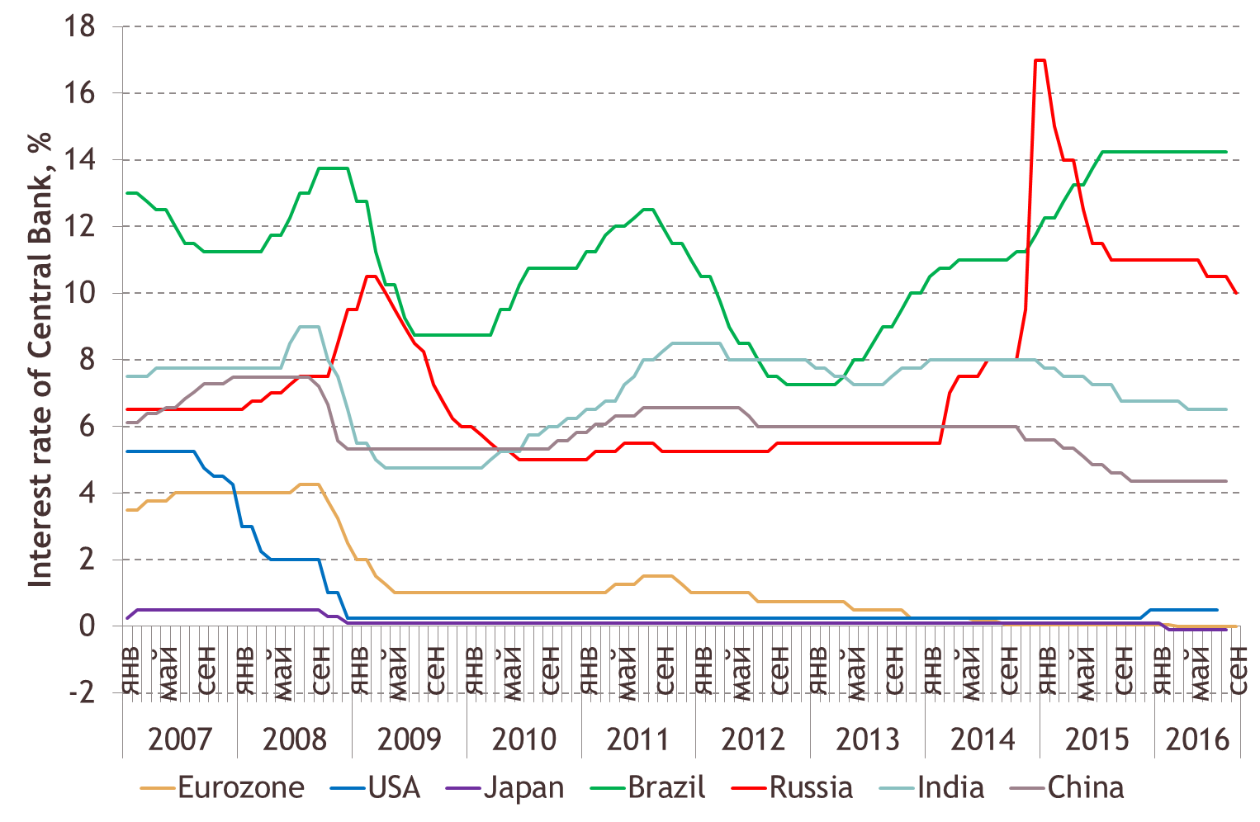
Interest rates of Central Banks

Slide 7
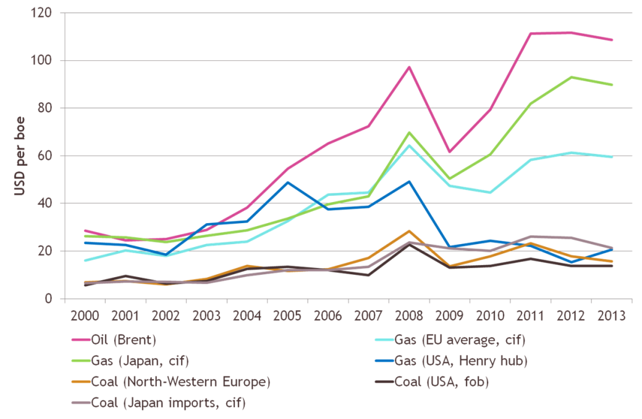
Energy prices: oil, natural gas, coal

Slide 8
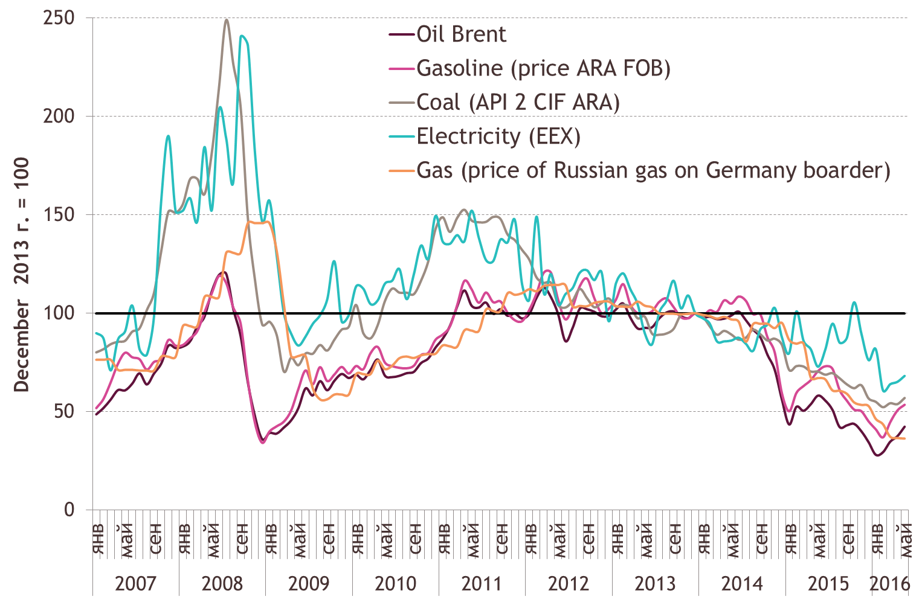
Energy prices: oil, natural gas, coal, electricity, 2007-2016

Slide 9
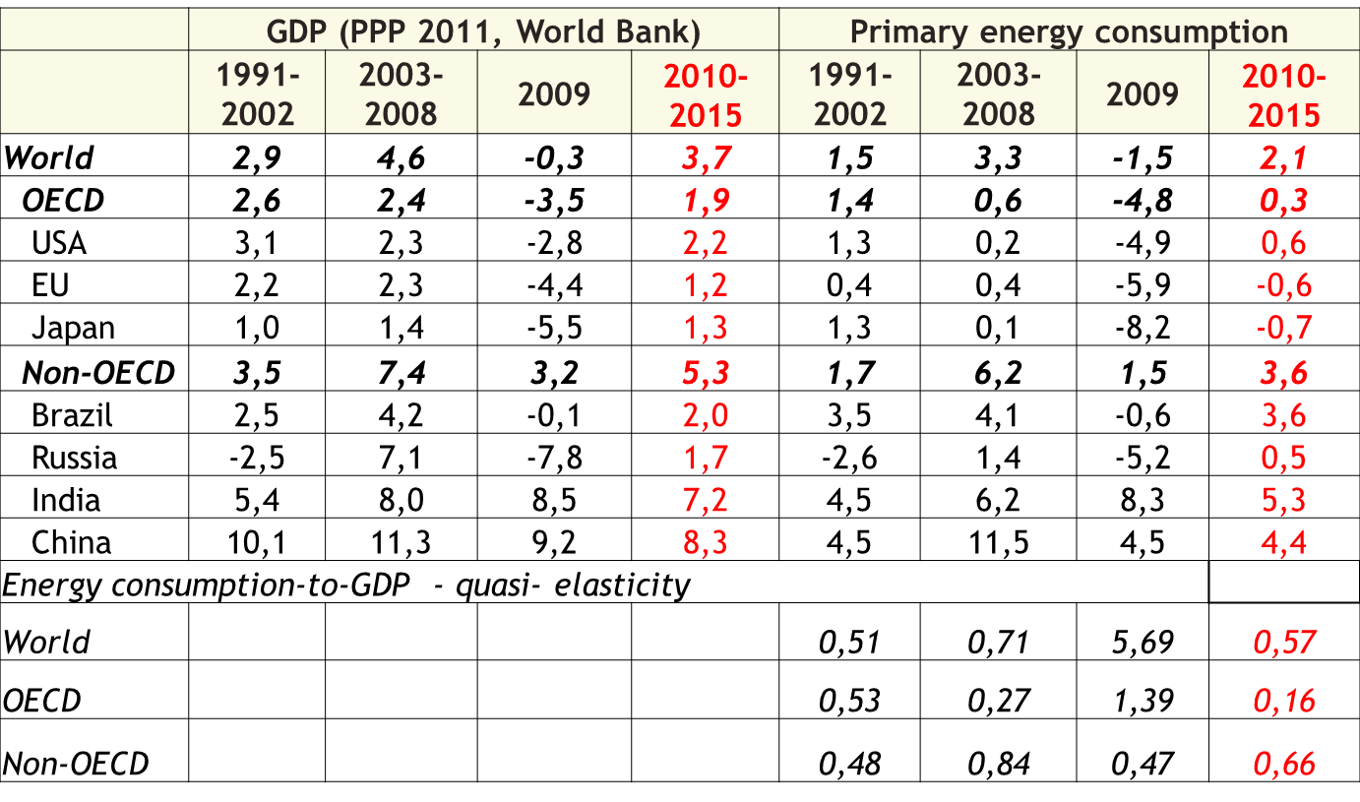
GDP and primary energy consumption, annual growth rates

Slide 10
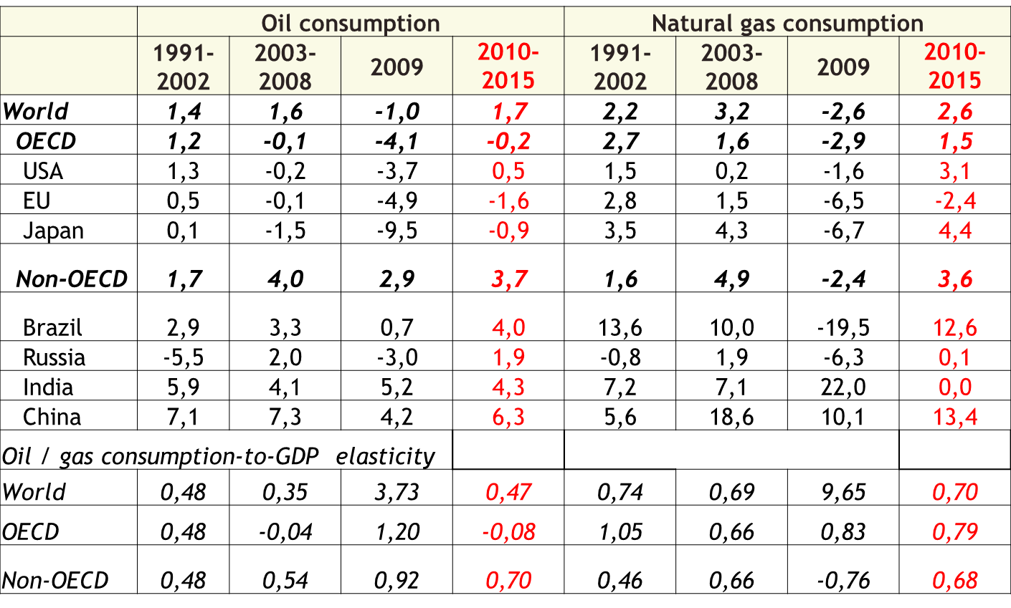
Oil and natural gas consumption, annual growth rates, 1991 - 2015

Slide 11
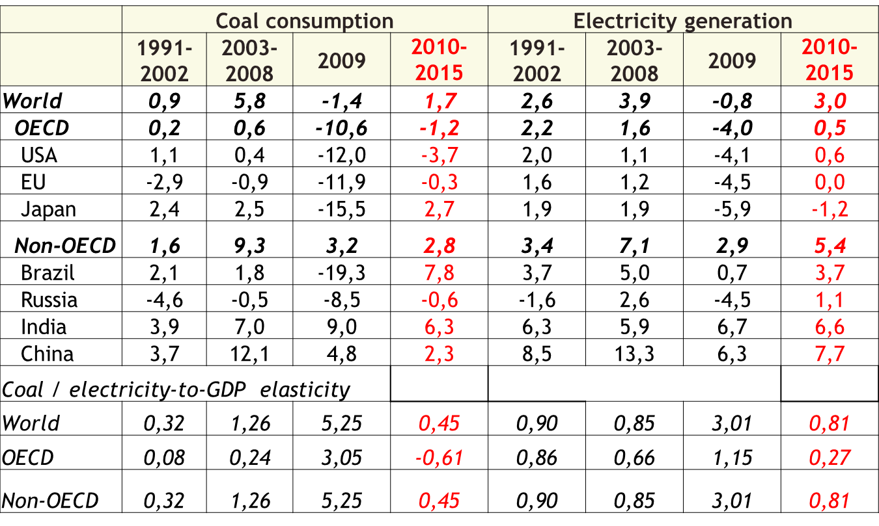
Coal consumption and electricity generation, annual growth rates

Slide 12
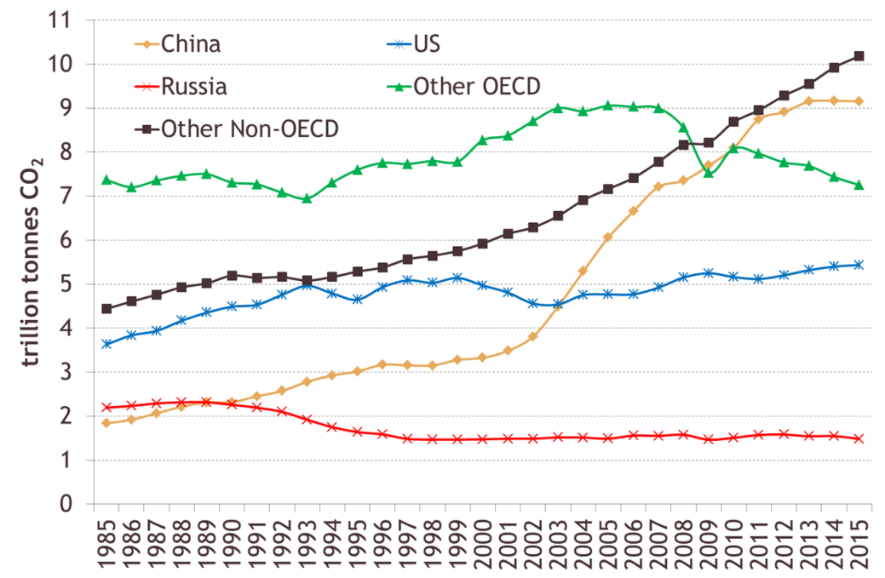
. Carbon Dioxide Emissions, bln tonn

Slide 13
Thank you for your attention!
Leonid Grigoryev lgrigor1@yandex.ru
Anna Lobanova a.lobanova@ac.gov.ru

