Slide 1





Gender equality in Russia:
UP – DOWN – UP AGAIN
Valeriia Gorbacheva
Adviser to the Executive Director
National Committee on BRICS Research (Russia)

Slide 2
Man and woman shall enjoy equal rights and freedoms and have equal possibilities to exercise them
Constitution of the Russian Federation
Article 19

Slide 3

Specific Russian context
Sustainable Development Goal –
Achieve gender equality and empower all women and girls
Russia is notable for women’s excess employment, inherited from the USSR (occupational segregation).
Russia is a highly industrial country in the process of technological transition to post-industrial economy.
Women’s average educational level is higher than that of men.
Still, there was no equality between men and women in Russia in economic, social and political life, but no serious discrimination in rights, at least not formal.

Slide 4

Gender pay gap and labour discrimination in Russia

Slide 5
25 years of socio-economic reforms
occupational segregation | women: education healthcare trade food light industry | men: heavy industry mining construction engineering
labour market actual inequality | man usually occupy high executive posts
gender pay gap | women receive about 2/3 of a men’s salary
lack of legislation initiative | Authorities do not consider this a vital issue
economic development gap between regions | better region – better female’s situation
patriarchal traditions | man considered as supporter of his family
gender stereotyping | women sacrifice career interests to family responsibilities

Slide 6
 | 2005 | 2007 | 2009 | 2011 | 2013
Total | 60,7 | 63,1 | 65,3 | 64,1 | 74,2
Agricultural industry, hunting and forestry | - | - | - | - | 83,5
Mining | 70,2 | 75,9 | 76,8 | 74,6 | 76,2
Manufacturing | 67,1 | 67,6 | 69,4 | 70,1 | 74,5
Production and distribution of the electric power, gas and water | 80,0 | 81,2 | 82,2 | 82,9 | 83,2
Construction | 77,0 | 79,2 | 86,3 | 85,8 | 84,5
Wholesale and home shopping service; repair of vehicles, motorcycles, household products and objects of private use | 68,4 | 68,6 | 65,1 | 67,5 | 79,8
Hotels and restaurants | 75,4 | 72,9 | 72,0 | 76,1 | 80,6
Transport and communication | 70,5 | 70,0 | 70,2 | 72,0 | 75,2
Operations with a fast estate, rent and rendering of services | 76,9 | 79,1 | 81,4 | 78,4 | 80,4
Research and development | 69,3 | 69,6 | 73,1 | 70,8 | 73,8
Education | 87,1 | 89,3 | 86,3 | 89,0 | 99,0
Health care and providing social services | 84,6 | 85,1 | 83,3 | 83,3 | 90,8
The relation of women’s salary to the men’s by the types of economic activity
Source: Rosstat

Slide 7
25 years of socio-economic reforms
occupational segregation | women: education healthcare trade food light industry | men: heavy industry mining construction engineering
labour market actual inequality | man usually occupy high executive posts
gender pay gap | women receive about 2/3 of a men’s salary
lack of legislation initiative | Authorities do not consider this a vital issue
economic development gap between regions | better region – better female’s situation
patriarchal traditions | man considered as supporter of his family
gender stereotyping | women sacrifice career interests to family responsibilities

Slide 8
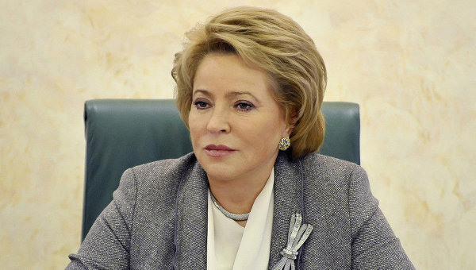
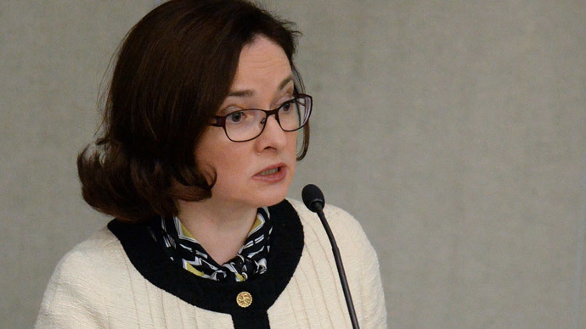
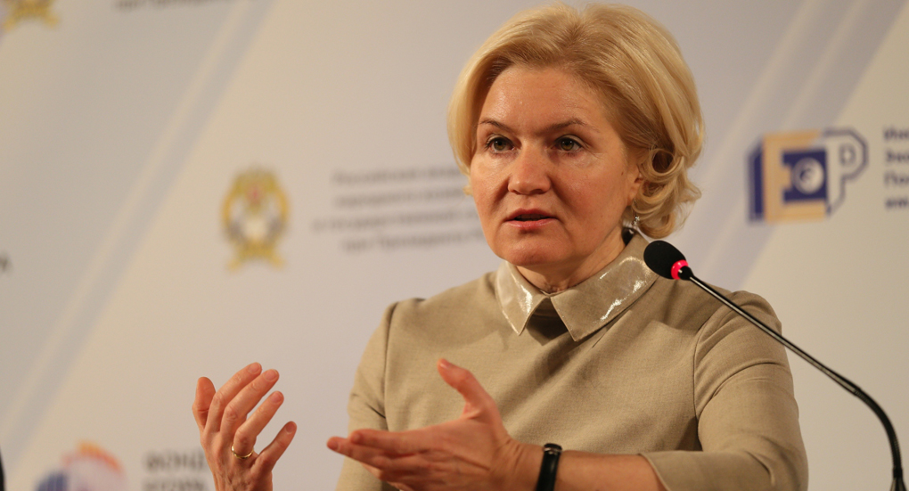
Russian Federation Council Speaker Valentina Matviyenko
Head of the Central Bank Elvira Nabiullina
Deputy Prime Minister Olga Golodets

Slide 9
2005 |  |  | 2015
Parlament
 | Lower Chamber |  | Lower Chamber |  | Upper Chamber
 | % | Women /all | % | Women /all | % | Women /all
Poland | 20% | 60/460 | 24% | 111/460 | 13% | 13/100
Spain | 36% | 126/350 | 41% | 144/350 | 34% | 90/266
Russia | 10% | 44/447 | 14% | 61/450 | 17% | 29/170
Ministries
 |  |  | % | Women | All
Poland |  |  | 28% | 5 | 18%
Spain |  |  | 31% | 4 | 13%
Russia |  |  | 7% | 2 | 31%
Women in parliaments and ministries
Source: UN

Slide 10


Thank you!
8TH BRICS ACADEMIC FORUM DELEGATIONS
BRAZIL | 7 | 1
RUSSIA | 6 | 6
INDIA | 13 | 6
CHINA | 10 | 1
SOUTH AFRICA | 8 | 2

