Slide 1

CHALLENGES FOR NDB: hydrogen energy Production
Dr., Prof. Irina Z. Yarygina
MEMBER OF THE BOARD, RESEARCH DIRECTOR, National Committee on BRICS RESEACH
Head of the Chair, MGIMO (U) Ministry for Foreign Affairs of the Russian Federation
Professor, Head of Programs, Financial university under the Government of the Russian Federation

Slide 2

Why hydrogen?
Economic and population growth as well as energy consumption
Hydrogen can become a new energy carrier (hydrogen economy)
Risks of energy security and development depend on mutual actions of the relevant actors
Hydrogen economy depends on R&D its infrastructure, a way to extract hydrogen, harmonized rules of fuel operating procedures.
Helps us to forget about exhaust gases, oil rigs and gasoline dependence forever

Slide 3
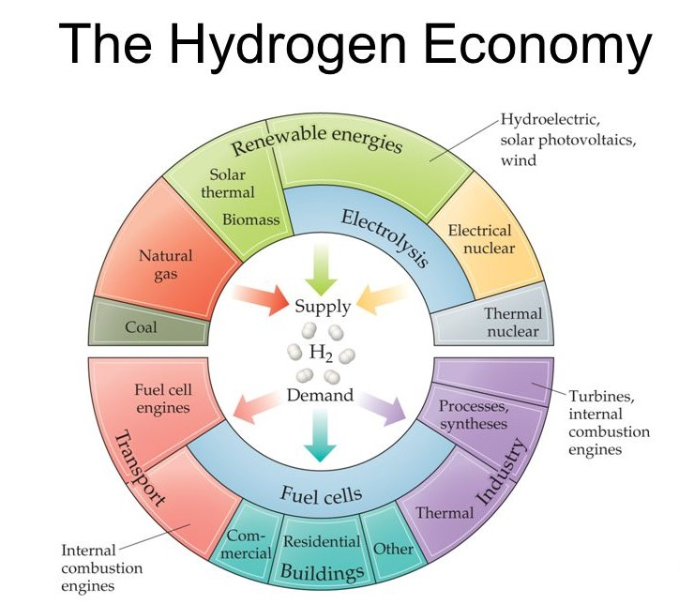

Slide 4
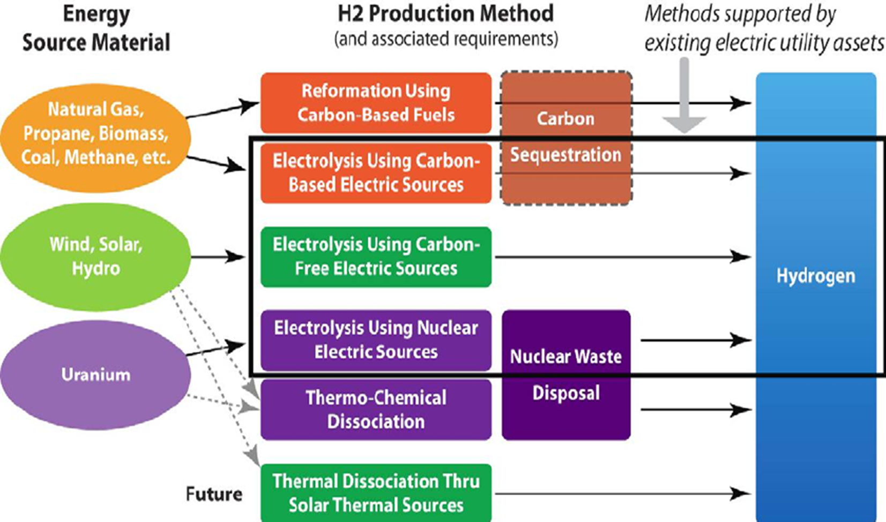
H2 production and usage requires Harmonization of BRICS rules and intergovernmental support

Slide 5
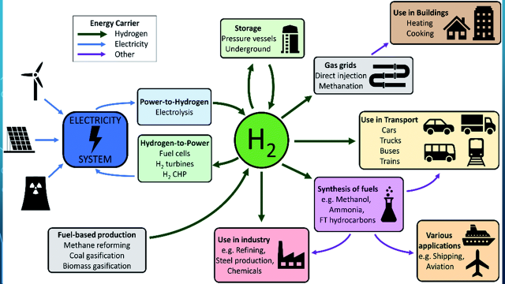
H2 production and usage REQUIRES Financing

Slide 6


transition measures of hydrogen energy PRODUCTION needs NDB Support
H2 production ( traditional )
Low carbon H2 production
Reduction of the carbon footprint of supply

Slide 7
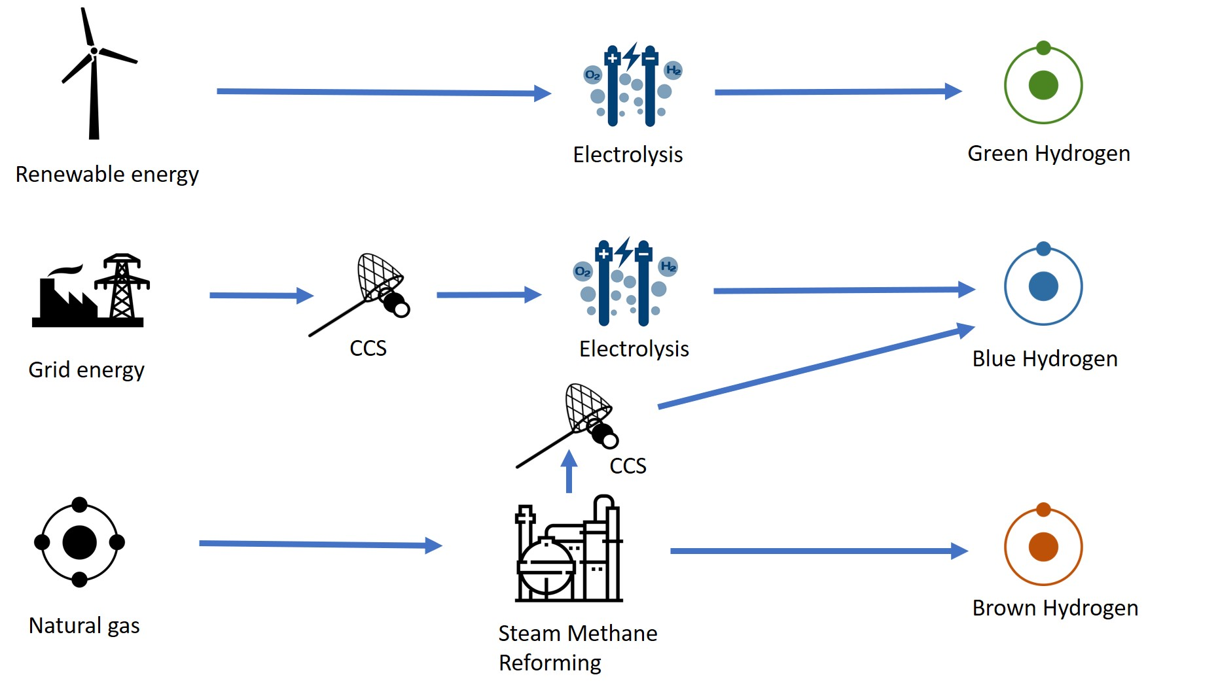
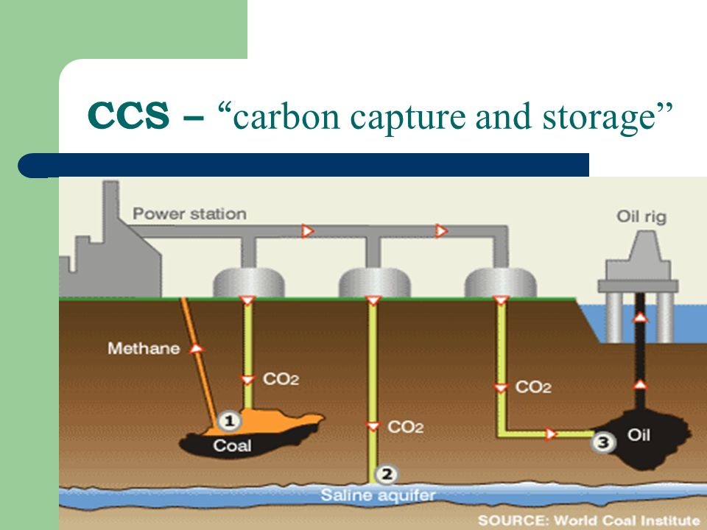
TYPES of HYDROGEN

Slide 8
Low Carbon supply contributes to
Positive impact on integrity and stability of supply system
Innovative fuel supply & its diversification
Environment protection
FINANCING
Low carbon hydrogen production, infrastructure of gas processing, storage, shipment

Slide 9

CHALLENGES FOR NDB partnership with
BRICS BANKS FOR DEVELOPMENT
Investments
TRANSITION PERIOD
PILOT PROJECTS
Investments in carbon-free and / or carbon-neutral hydrogen production technologies to improve technical and economic characteristics & contribute to the reduction of CO2 emissions
In the medium term:
the usage of "blue", climate-neutral hydrogen technology to ensure the production of "green" hydrogen from renewable energy sources (till 2030)
Joint BRICS pilot projects for the development of a pilot plants for the production of hydrogen and find the most effective and economically feasible technological solutions

Slide 10

BRICS CHALLENGES
INTERGOVERNMENTAL CONSORTIUM
renewable energy FINANCING
Safe environment FINANCING
Establishment of Consortium for pilot projects of H2 production from natural gas
(new jobs creation, sustainable economic development)
Acceleration of renewable energy financing to ensure in the medium and long term the growing domestic and external demand for" green " hydrogen
In the long term:
transition of resource-intensive production to "green" energy carriers based on hydrogen to reduce carbon dioxide emissions into the atmosphere

Slide 11
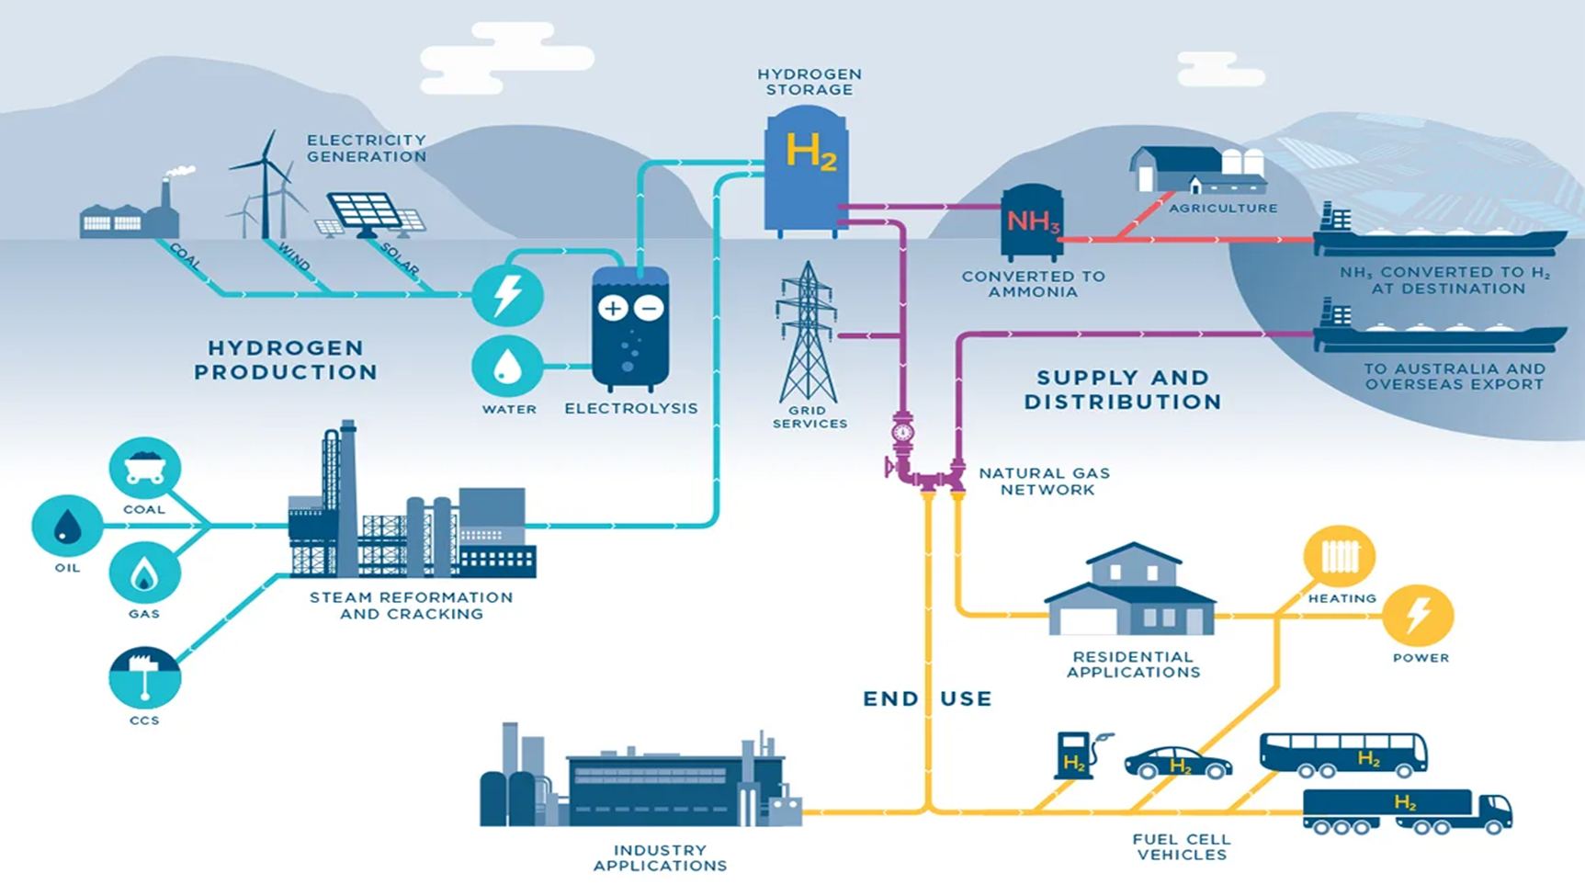
NDB & Partners for H2 REPRODUCTION СYCLE

Slide 12



Thank You for the attention
jiz4@yandex.ru

