Slide 1

NDB and evolving agenda for development cooperation
Leonid Grigoryev
Higher School of Economics
Alexandra Morozkina, phD
Higher School of Economics
5 April 2022

Slide 2
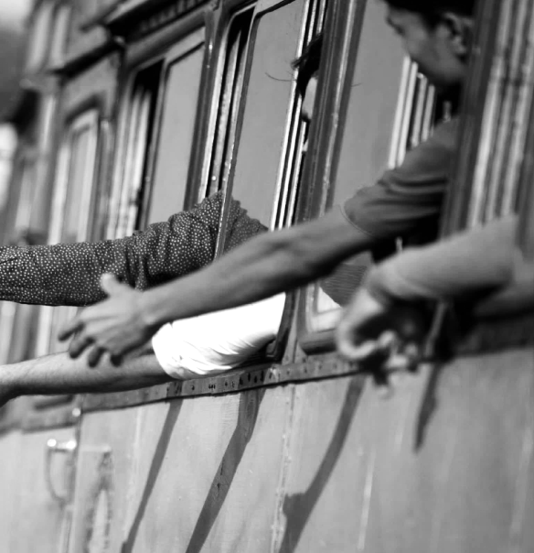
SDG1. Poverty
SDG2. Food
Catastrophic effect on SDGs
Share of population living on 1.9 USD/day increased from 8.7% in 2019 to 9.6% in 2020
In absolute terms – by 80 mln people
Food index calculated by the WB raised from 88 (2010=100) in 2015 to 141 in February 2022
Number of undernourished increased from 650 mln people in 2019 to 768 mln in 2020 (est)
SDG3. Health
SDG4. Education
SDG 8. Growth
6.1 mln deaths from COVID-19 as of March, 30 (Target 3.3 unrealistic)
Life expectancy in 30 European countries down in 2020
In April 2020, schools in 173 countries were closed due to lockdown measures
in 7 more countries schools were only partially open
Unemployment up from 5.4% in 2019 to 6.6% in 2020
Global growth down from 2.8% in 2019 to -3.1% in 2020

Slide 3


Health expend., per cap., 2019, USD
Total COVID-19 deaths, % of pop
Total COVID-19 cases, % of pop
Share of fully vaccinated, % of pop
Differences in healthcare systems
High-income
5 736
0.19
22.3
74
USA
10 921
0.30
24.3
66
UK
4 313
0.35
31.5
72
France
4 492
0.21
37.8
78
Germany
5 440
0.16
25.4
75
Upper-middle income
555
0.10
4.9
76
Brazil
853
0.31
14.1
75
China
535
0.0
0.0
86
Russia
653
0.25
12.2
50
Lower-middle income
95
0.04
2.7
50
India
64
0.04
3.1
60
Philippines
142
0.05
3.4
59
Low-income
34
0.01
0.3
11
No public call for review of the health financing and institutional settings
in the new environment despite uneven performance of healthcare systems

Slide 4
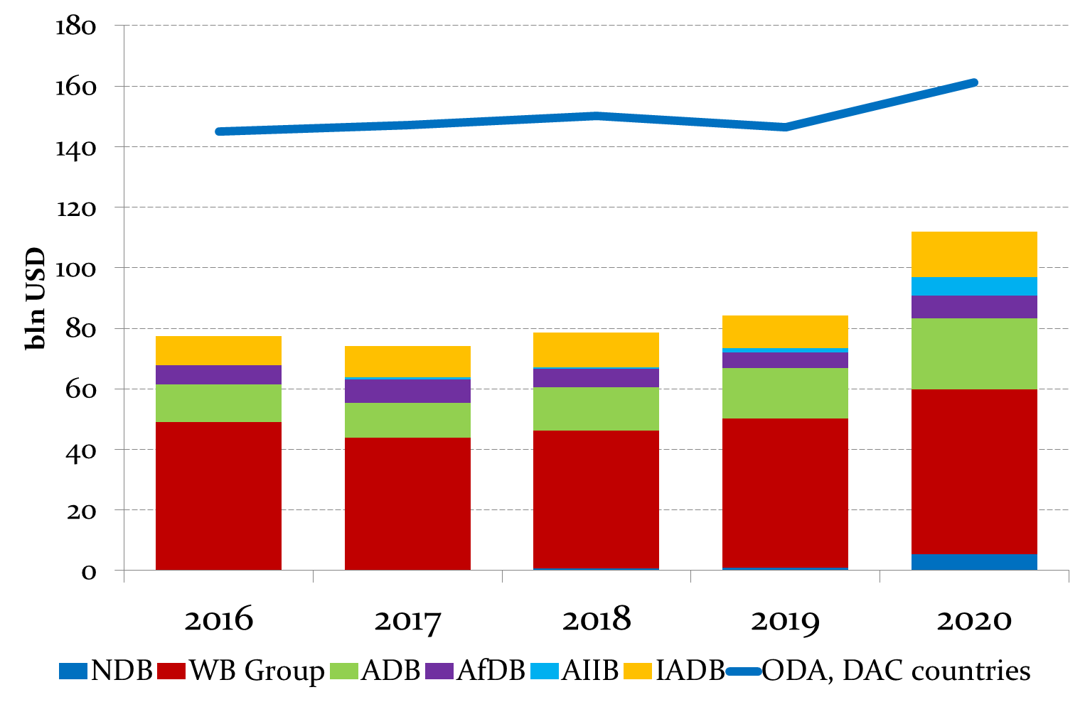


Counter -cyclical role of MDBs
was again justified in 2020
MDBs contribute to sustainable development in different ways
Key MDBs saw a 33% increase
of their disbursements in 2020
Alignment of operations with SDGs
Is a second way of MDB’s contribution to the sustainable development. NDB publishes its contribution to the SDGs in the annual report and takes sustainability of a project into consideration as one of criteria for approval.
MDBs act as norm promoters and agenda-setters
By conducting pioneer research, maintaining databases and introducing new instruments to the market
Mobilization role of MDBs
22.6 bln provided by NDB allowed to finance projects with a total amount of 77.5 bln USD (sum only for those projects where the total value is available)

Slide 5

Selection of projects
We used only approved projects, including technical assistance (=80, total amount 30 bln USD)
Alignment to SDGs
Taking into account only direct impact (not accounting for potential economic or social benefit, e.g. increased income for rural households from improved road connection, or effect of improved sanitation on community health).
102 projects in the NDB database, including 17 proposed and 5 cancelled
Each project might have a reference to several SDGs;
Mapping using correlation of project targets and SDG targets
How NDB contributes to SDGs: our methodology

Slide 6

Number of projects
Cumulative approvals (USD mln)
Share of approvals
NDB’s contribution to SDGs: results
SDG 1. No poverty
3
3 000
10
SDG 2. No hunger
1
100
0.3
SDG 3. Good health and well-being
5
4 114
13.7
SDG 4. Quality education.
3
650
2.2
SDG 6. Clean water and sanitation
12
3 619
12.1
SDG 7. Affordable and clean energy
18
5 690
18.9
SDG 8. Decent work and economic growth
14
8 448
28.1
SDG 9. Industry, innovation and infrastructure
41
12 654
42.1
SDG 11. Sustainable cities and communities
10
3 586
11.9
SDG 13. Climate action
2
600
2.0
SDG 16. Peace and justice strong institutions
1
460
1.5
SDG’s alignment of NDB is consistent with its mandate
NDB primarily contributes to the goals that raise the least number of question in terms of changed circumstances, such as SDG 6, SDG 7, SDG8, and SDG 9.
Bank has quickly stepped in during pandemic in 2020
provided loans aimed at social aspects such as social protection, education, and healthcare.

Slide 7

Setting of agenda
Shaping the new SDG agenda taking into account the current challenges uncovered by the latest global crises;
Publishing reports on SDGs in member countries
Financing SDGs
Incorporation of new SDG realities in Banks’ strategy (increase of the role of especially crisis-hit sectors)
Information disclosure
more transparency on NDB financing by sub-projects, especially with different SDG-alignments
more clear articulation of projects’ contribution to SDGs
Conclusions and recommendations

