Slide 1
BRICS, AFRICA AND GLOBAL ECONOMIC GOVERNANCE: ACHIEVEMENTS AND THE FUTURE
Elizabeth Sidiropoulos, Cyril Prinsloo,
Luanda Mpungose, Neuma Grobbelaar.

Slide 2
Introduction and Overview
Contextualisation
Taking stock of BRICS achievements over the past decade
Assess BRICS - Africa cooperation
Scope: Economic achievement and cooperation
Interviews and Surveys
BRICS and Global Economic Governance (IMF, WB)
BRICS and Africa Cooperation
Recommendations

Slide 3
1. BRICS and Global Economic Governance
Four Stages
2000s – 2007/2008 – Consensus Building
Different formations (IBSA, BASIC); challenging policy positions; global inequality
2009 – 2012 – Formation and Reform as ‘Inside Initiatives’
2012 – 2017 – Enterprise: Reforms through Parallel Institutions, ‘Outside Initiatives’
2018 – Strategic Cooperation
BRICS Plus, BRI, AAGC, etc.

Slide 4
1. BRICS and Global Economic Governance
2009 – 2012 - Inside Initiatives
Objective: Reform in the IMF and WB (voting shares, quota formula, leadership positions)
Achievements
IMF: BRICS increase of 3.1% (total 14.1%); WB: BRICS increase 1.84% (total 13.1%)
Other EMDCs also increase in IMF – South Korea, Singapore, Turkey, Mexico
Open and competitive election of top positions
Challenges
Much of the voting shift happened within EMDCs
Institutional power remains e.g. veto power in IMF
Open campaigning, yet BRICS fail to coalesce around single candidates

Slide 5
1. BRICS and Global Economic Governance
2012 – 2017 – Outside Initiatives
Achievements
Establishing the New Development Bank and the Contingent Reserve Arrangement
Business model remain the same, operational model changes (UCS, local currencies, local lending)
Healthy competition in the market + address infrastructure finance deficit
Challenges
Expanding its reach beyond the core group
African countries – clear, but waning interest

Slide 6
2. BRICS - Africa Cooperation
South Africa’s Foreign Policy – altruism and national interest
Priorities aligned with AU and Agenda 2063 – Infrastructure Development and Industrialisation
SA in the BRICS - Strong continuity from 2011 onwards
Outreaches and Priorities
BRICS + Neighbourhood – 2013 Outreach
2018: ‘BRICS in Africa: Working towards the realisation of the African Aspirations’
Engagement remains largely bi-lateral
FOCAC, India – Africa Summit, South America - Africa Cooperation Forum, Russia – Africa (2019)

Slide 7
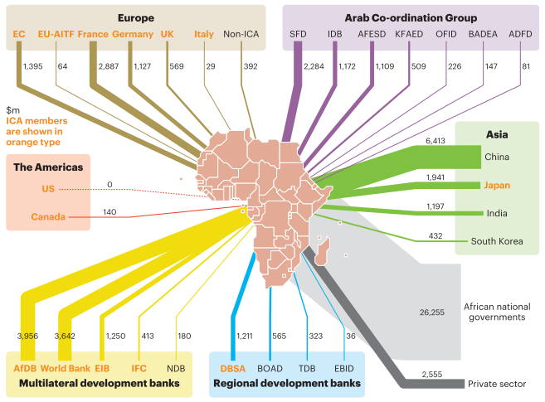
2. BRICS - Africa Cooperation
Infrastructure Development
China, India, SA have become important bilateral creditors in Africa
Rising debt stock – In Djibouti, 3 Chinese-backed projects increased the country’s debt-to-GDP ratio from 50% in 2015 to 85% in 2016 (IMF)
Debt not bad
Transparency is important
Source: ICA (Infrastructure Consortium for Africa), ‘Infrastructure Financing Trends in Africa 2016’

Slide 8
2. BRICS - Africa Cooperation
Trade, Investment and Industrialisation
Inequitable trade
African Continental Free Trade Agreement holds significant potential to enhance BRICS – Africa cooperation
AfCFTA – 1.2 billion people, $2.5 trillion GDP (AU)
African Agency
African research on BRICS
Institutional arrangement (Guinea, Rwanda)

Slide 9
3. Recommendations
Hybrid Model of Global Governance Reform
Inside Initiatives – broader cooperation to overcome institutional power dynamics
Outside Initiatives – NDB value proposition to prospective members; communicate timelines and clarifying expectations
BRICS – Africa Cooperation
Support the data transparency initiatives
African policymakers, researchers and the business community should work synergistically to identify areas of cooperation with the BRICS
AUC should set up a dedicated BRICS unit to provide support on BRICS-related issues to the rotating AU chairs

